Slide 1
WATER RESCUE and GIS
LIEUTENANT RONALD VAUGHN EMT-PARAMEDIC
DALLAS FIRE RESCUE GIS SUPERVISOR

Slide 2
Brief History of DFR GIS
What we did?
Park Trails
Made Maps
The Goal
To make the Department aware of GIS
Educating the Department on the value of GIS
Being a voice for GIS
Providing the Command Staff with GIS Data
Providing Tools to assist Firefighters in the Field

Slide 3
DFR GIS

Slide 4
Why was GIS was notified?
The Situation
New crew at the station: 33 out of 36 individuals staffed were new. Three Shifts 1 individual per shift familiar with the lake.
Wanted Map for Training
Map of the Boat Ramps and Marinas of Lake Ray Hubbard
Parks
Low Laying Areas of the Lake
ETC

Slide 5
DFR WATER RESCUE
The Purpose of the water rescue program is to provide specially trained resources that will be available to complement existing resources in affecting the rescue or recovery of victims from moving or stationary bodies of water. The water rescue program is divided into three separate entities consisting of:
7 Boat Rescue Stations
Swift Water Rescue
Flat Bottom Boat Companies
Marine 1 (Lake Ray Hubbard)

Slide 6
WATER RESCUE TEAM STATION 39

Slide 7
MARINE ONE

Slide 8
LAKE RAY HUBBARD
Location: In Collin, Dallas, Rockwall and Kaufman counties, one mile west of Rockwall on the East Fork of the Trinity River
Surface area: 21,671 acres
Maximum depth: 40 feet
Cities: Dallas, Garland, Rowlett, Sunnyvale, Rockwall, Wylie
Source Texas Parks and Wildlife

Slide 9
LAKE RAY HUBBARD

Slide 10
LAKE RAY HUBBARD
The Good
The Bad
The Ugly
The Good

Slide 11
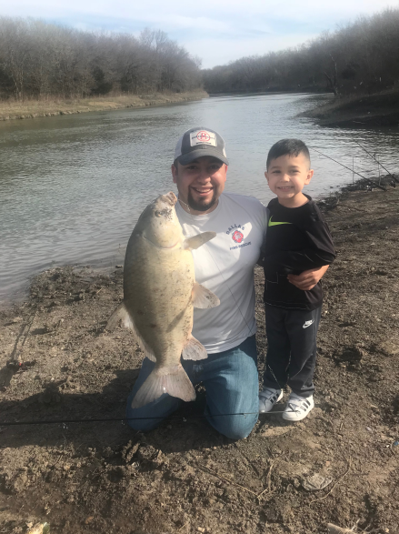
LAKE RAY HUBBARD
Angling Opportunities
Hybrid Striped Bass
Blue Catfish
Largemouth Bass
White Bass
Channel Catfish
White Crappie

Slide 12
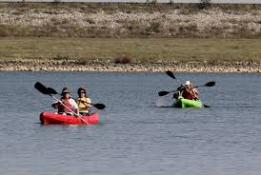
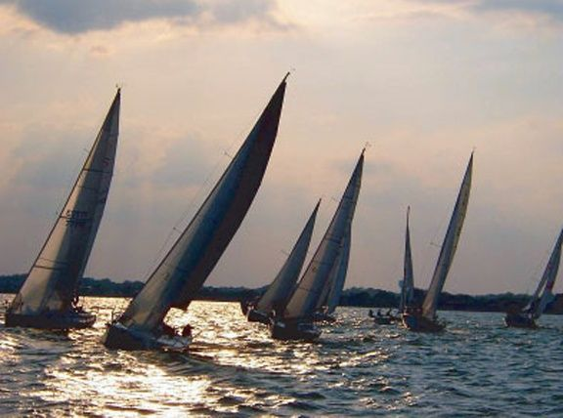
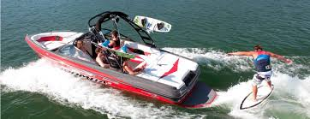
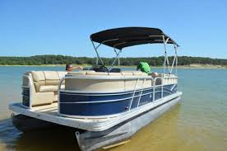

Slide 13
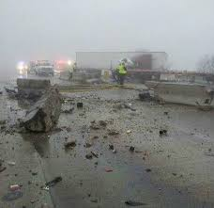
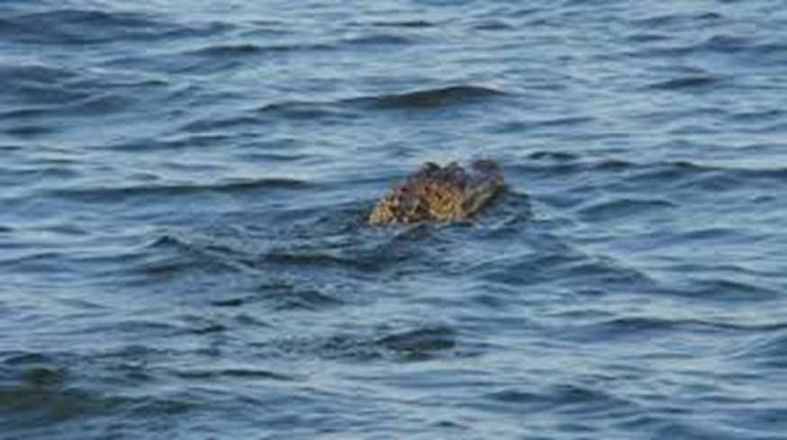
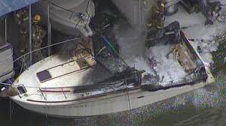
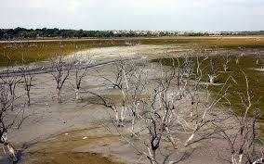

Slide 14
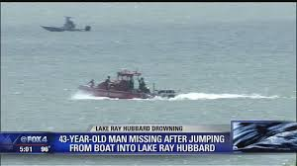
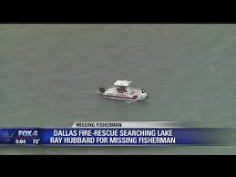
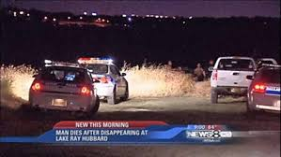

Slide 15
LAKE RAY HUBBARD 72 CALLS 2018

Slide 16
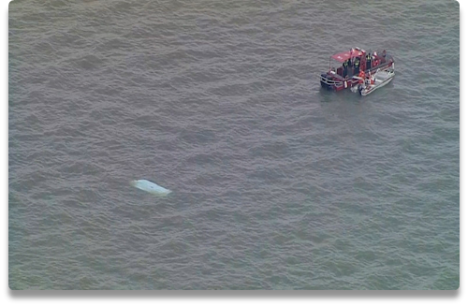
LAKE RAY HUBBARD 61 CALLS THRU SEPTEMBER 15 2019

Slide 17
WHAT DID GIS DO?
Meet with the Boat Crew
Looked at other Maps Being Used
Made Suggestions Using X Y Coordinates
Using Collector
Spent Two days with the Boat Team
Familiarization of the Lake
Made them an up to date map
Build an App of the Lake used with I-Pad

Slide 18
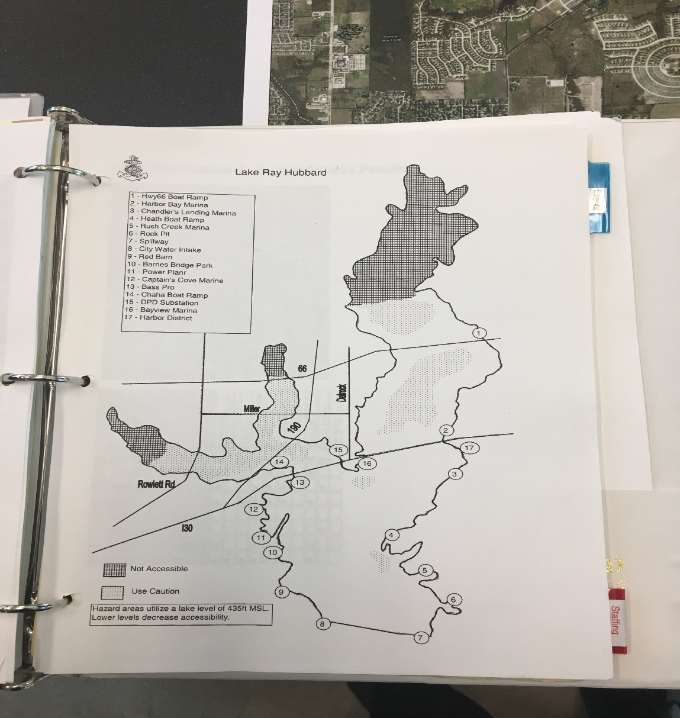
What was being used

Slide 19
Field Work on Land

Slide 20
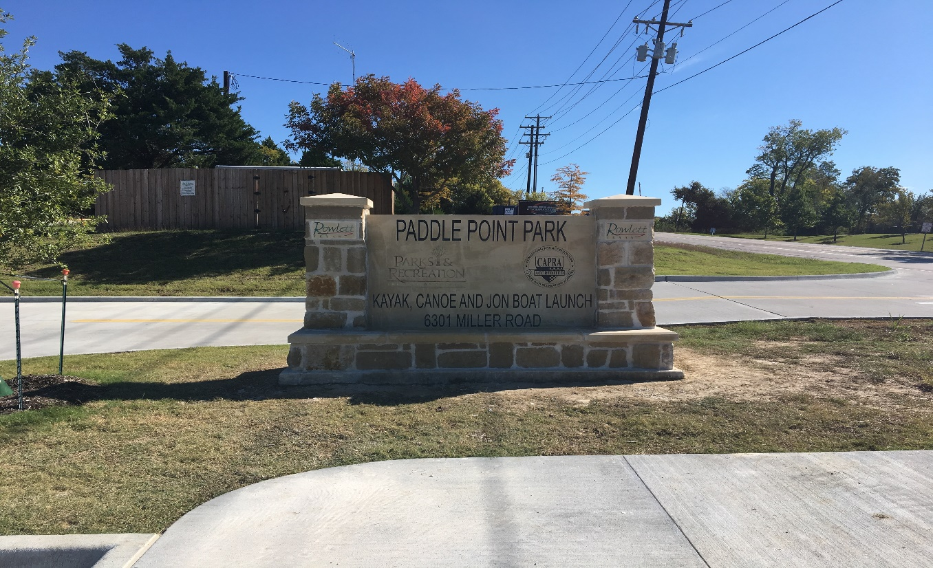
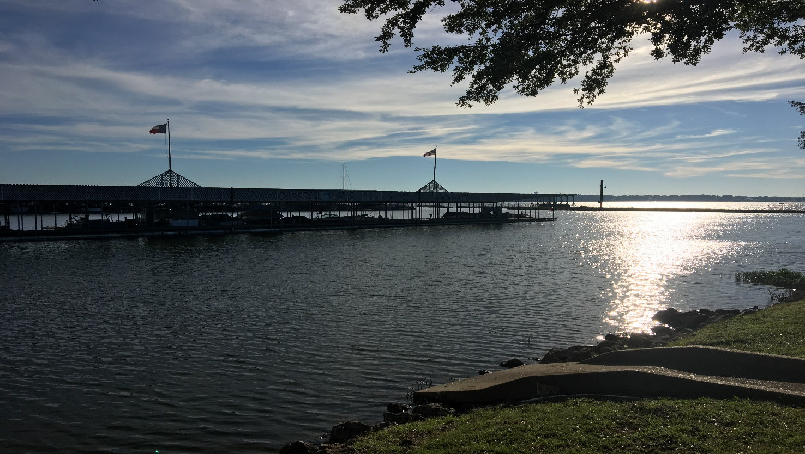
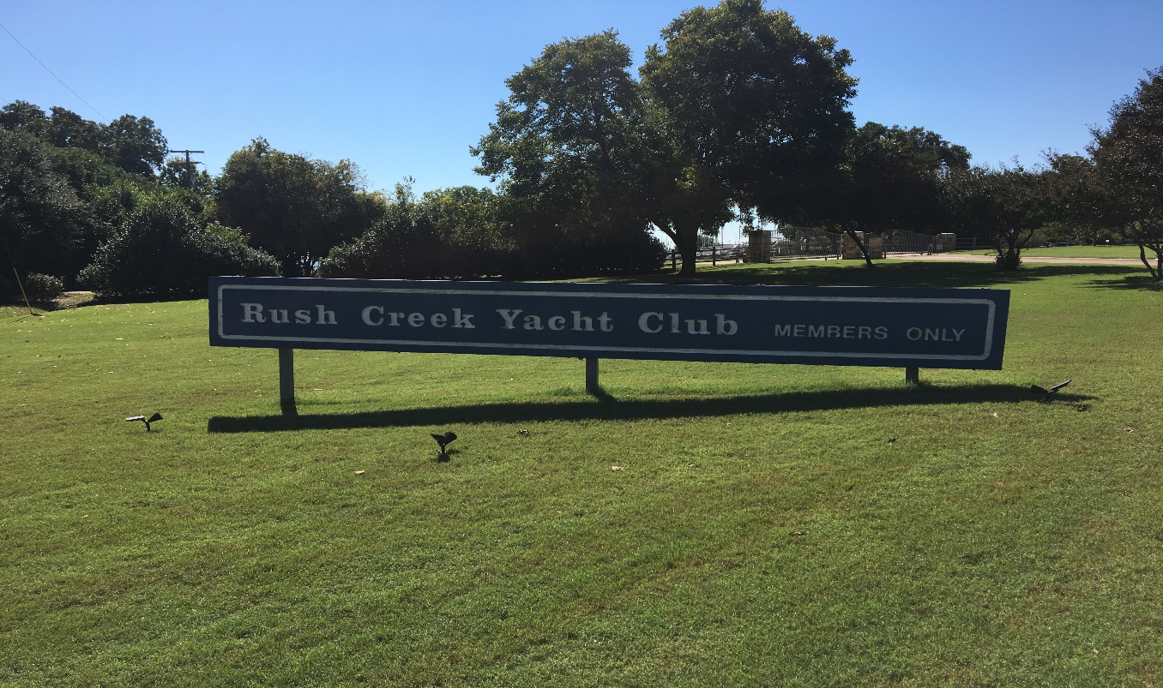
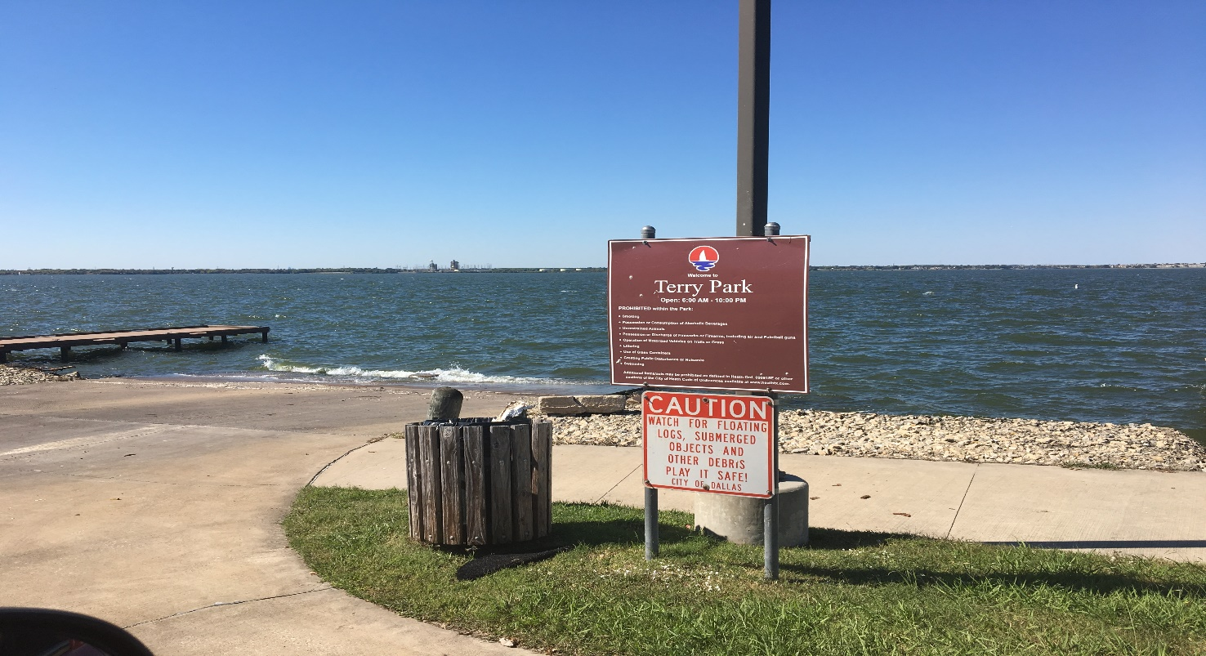

Slide 21
Field Work on the Lake

Slide 22
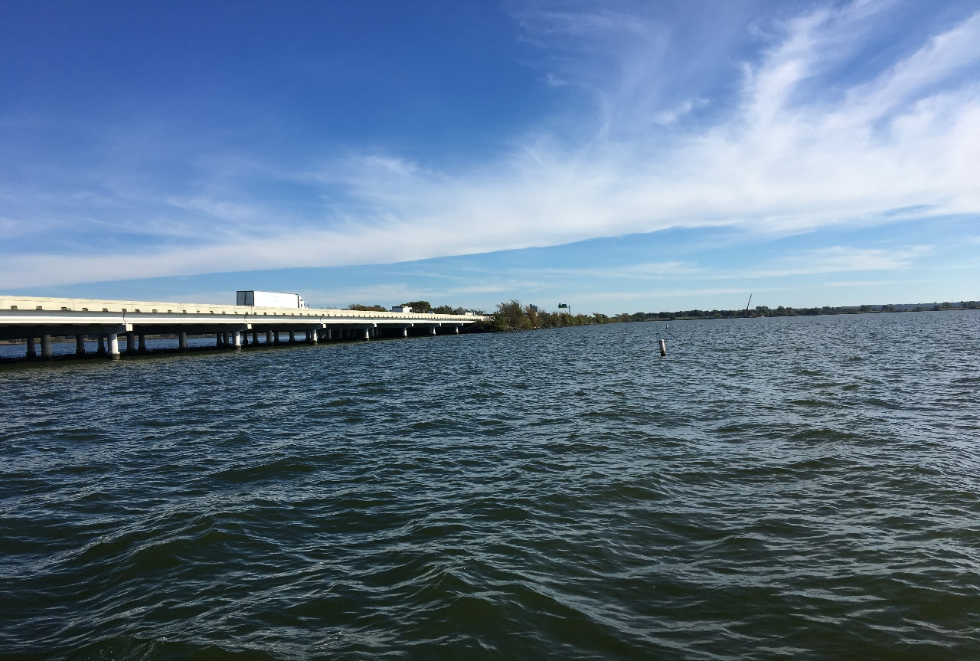
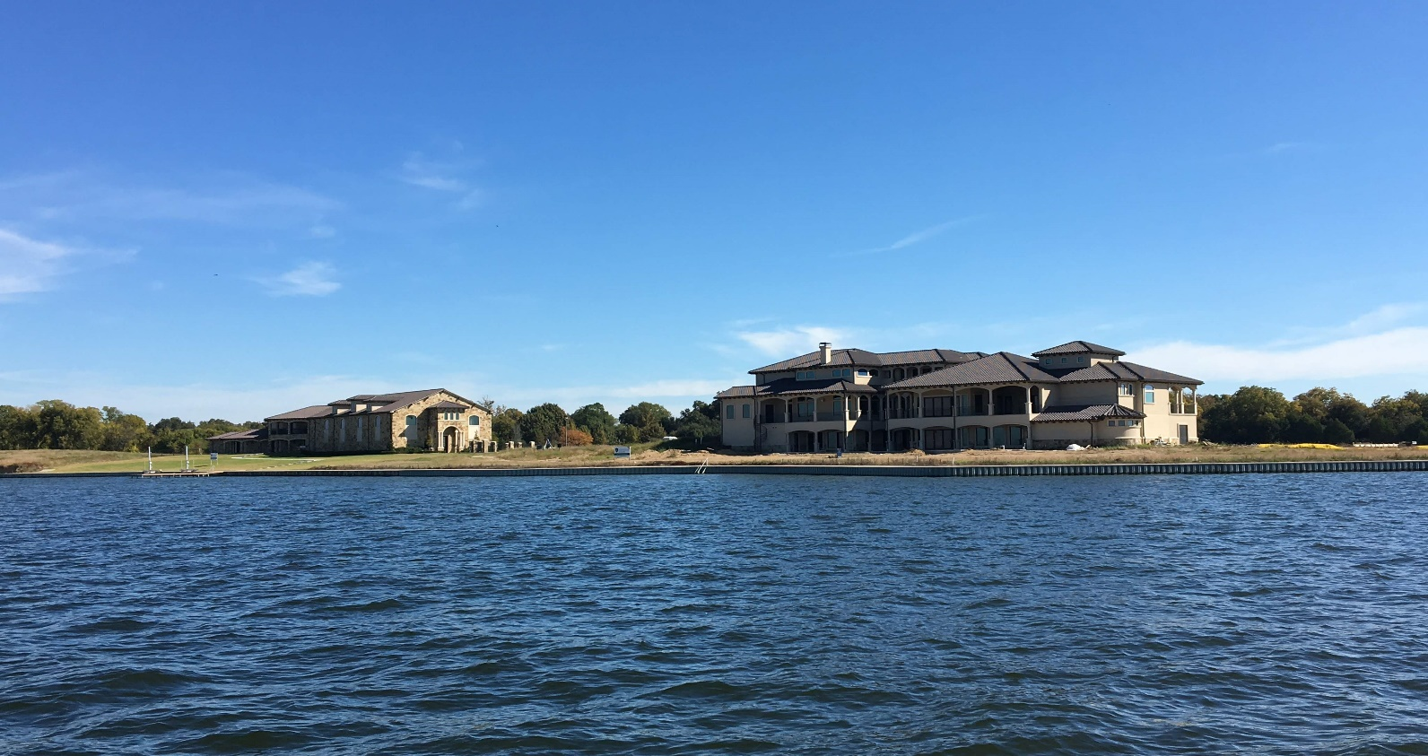
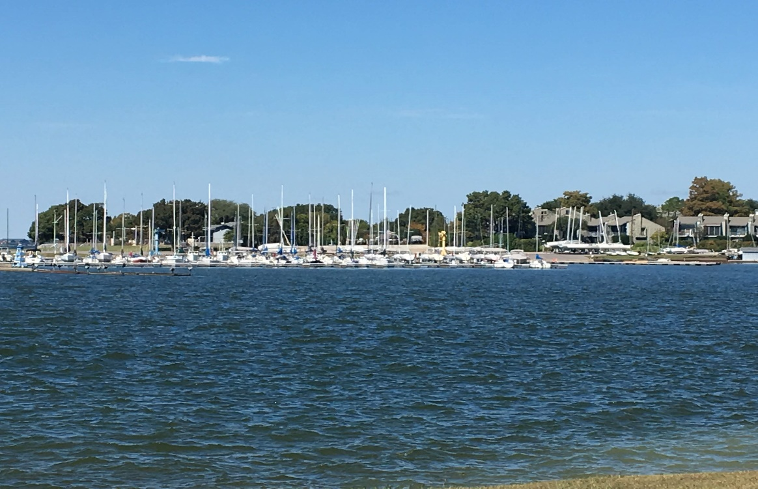
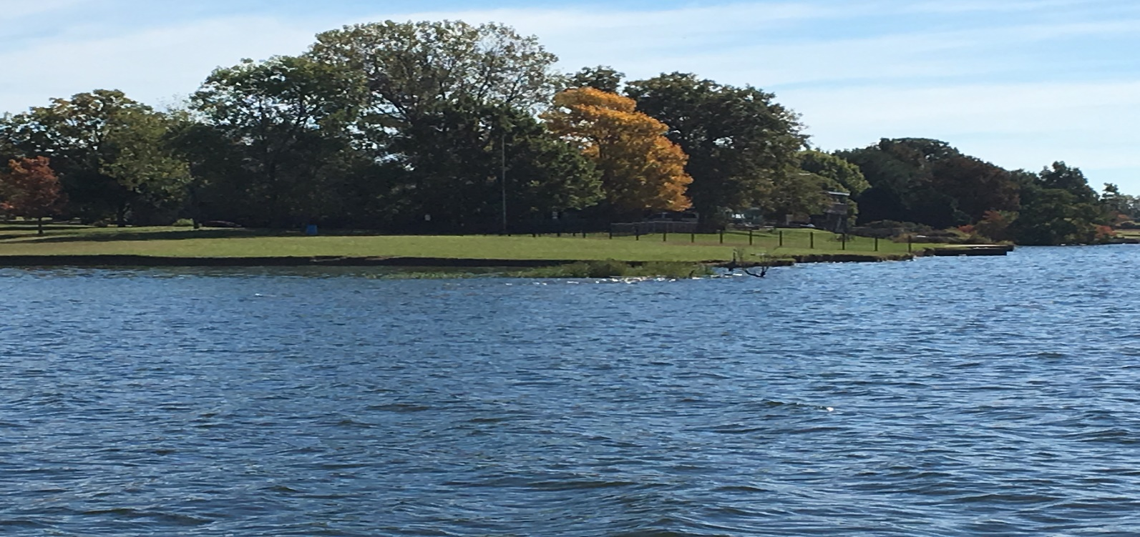

Slide 23
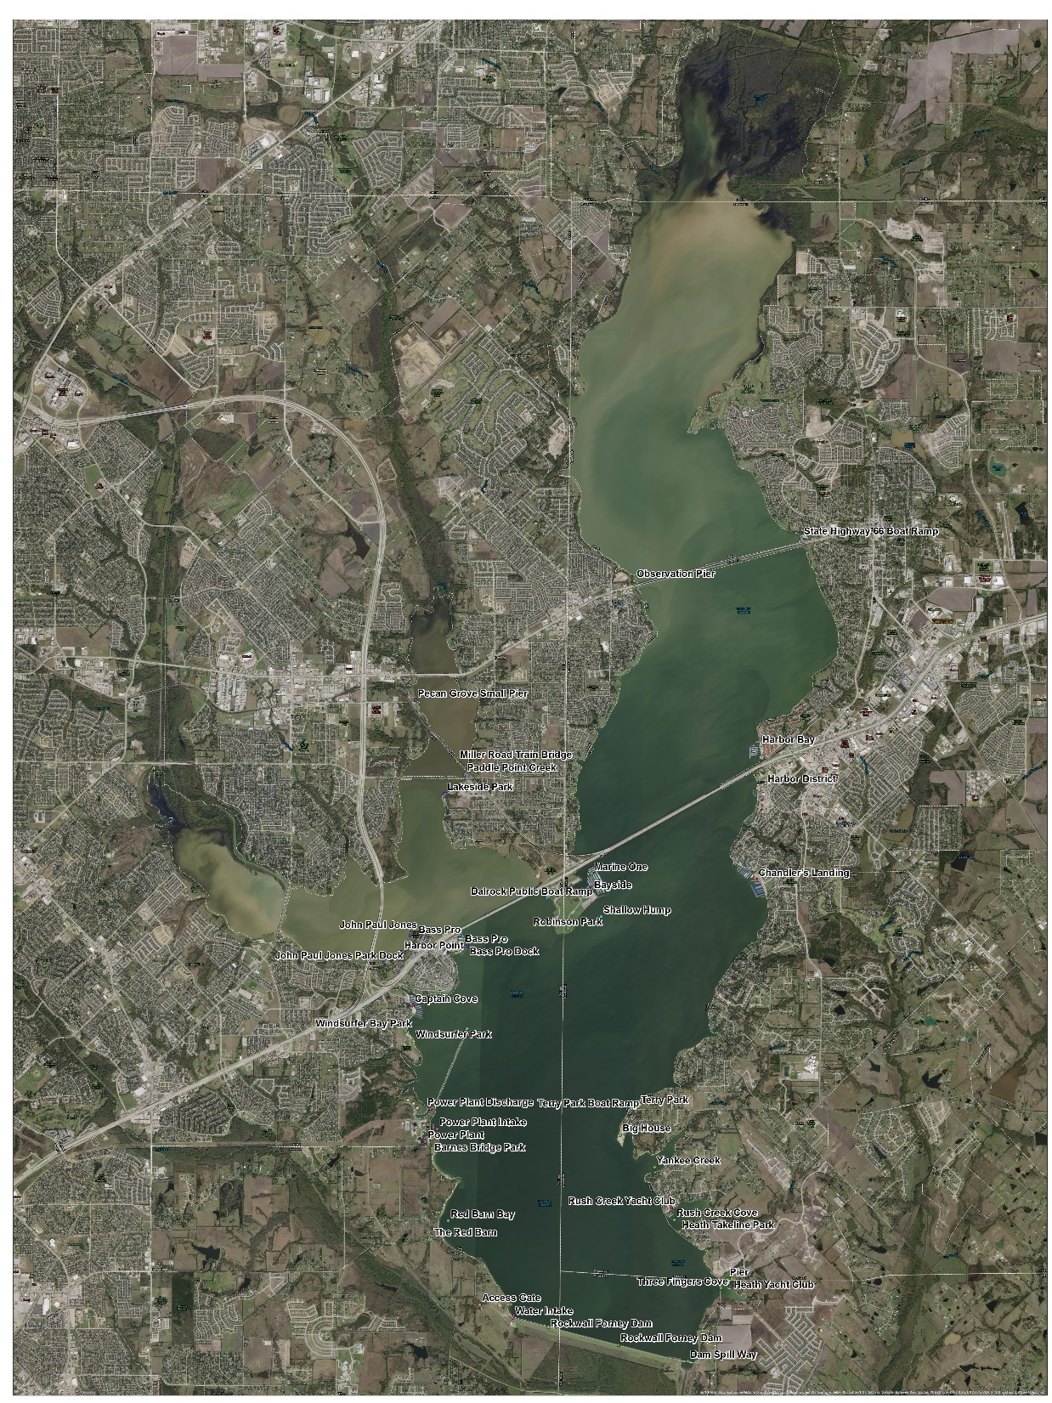
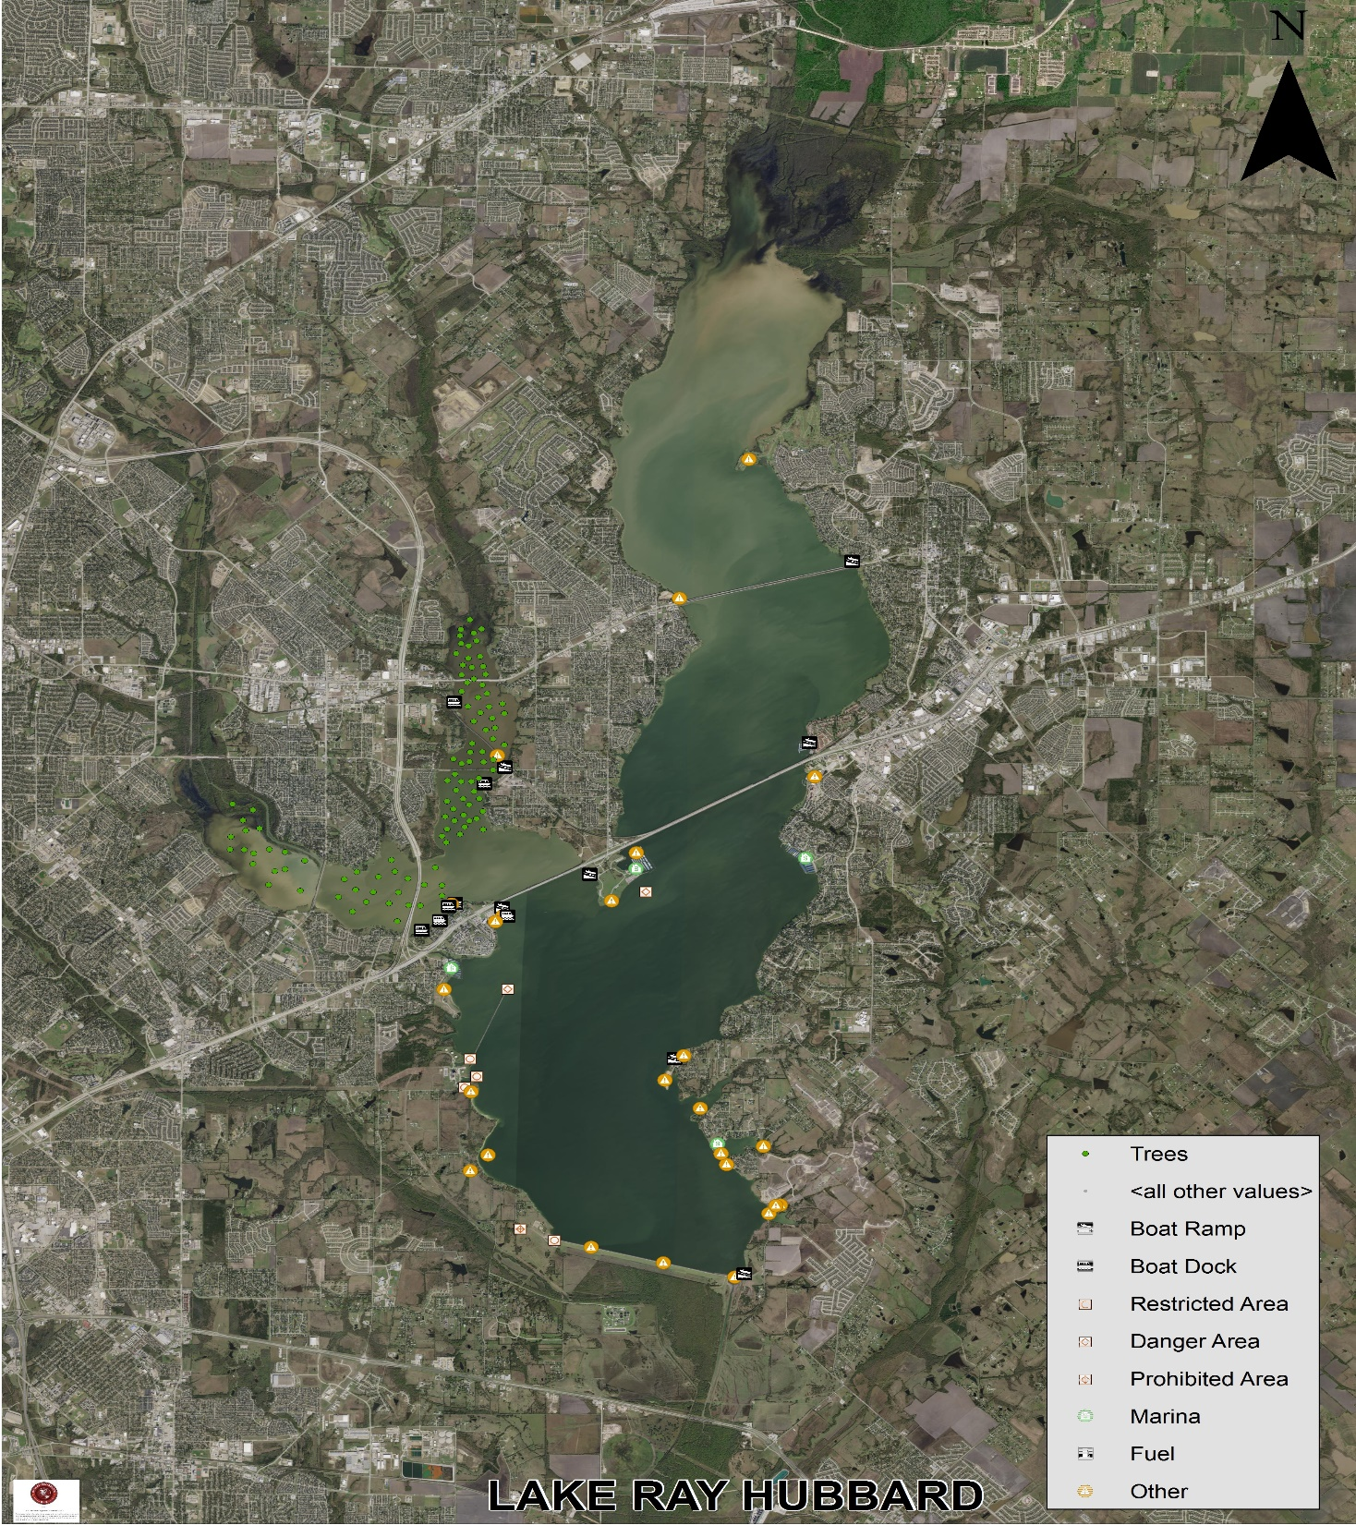

Slide 24
DEMO LAKE RAY HUBBARD AP
https://dallasgis.maps.arcgis.com/apps/webappviewer/index.html?id=b6493631a475423584bf2e61288a56aa

Slide 25
Future of GIS and Water Rescue

Slide 26
LAKE RAY HUBBARD WATER RESCUE

Slide 27
STATION 39

Slide 28
THANK YOU
CONTACT INFORMATION
LIEUTENANT RONALD VAUGHN
1500 Marilla Street #3EN
Dallas Texas 75201
Office- 214-670-3352
Cell- 469-744-2956
ronald.vaughn@dallascityhall.com
Linkedin.com/in/ronald-vaughn-
14b823146

