Slide 1
This Land is My Land
How Ownership of Real Estate Happens

Slide 2
Question and Contact
Tami Mohow
mohowt@canadiancounty.org
Joel Foster
fosterj@canadiancounty.org

Slide 3
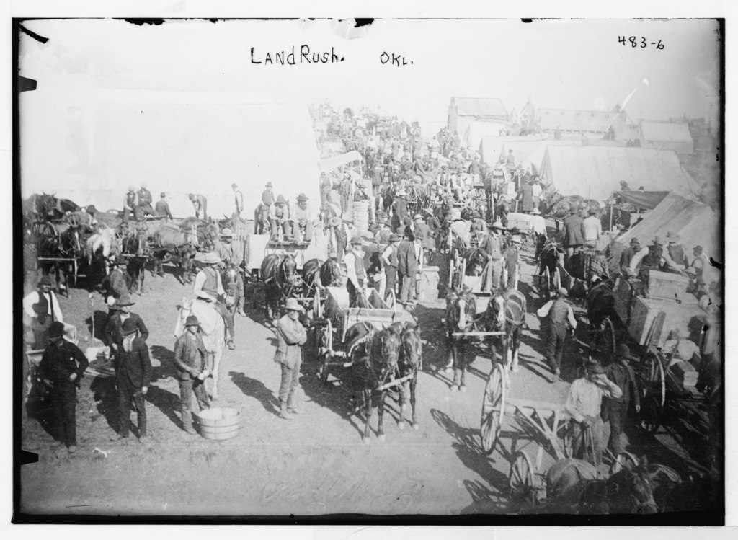
First Oklahoma Land Run
April 22, 1889
2,000,000 Acres

Slide 4
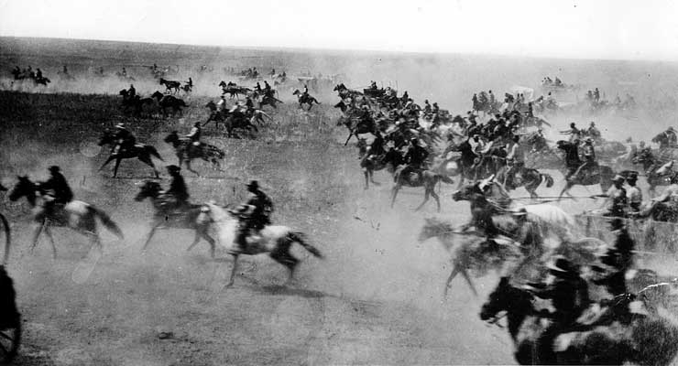
First Oklahoma Land Run
Estimated 50,000 people lined up to claim tracts of up to 160 acres.

Slide 5
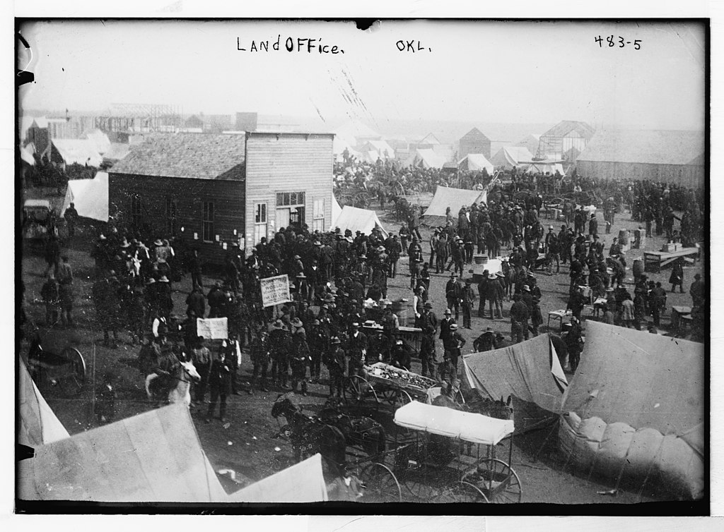
First Oklahoma Land Run
62,000 settlers by end of year

Slide 6
School Land
Sections 16 & 36 of most townships were set aside as School Land, which could be leased but not homesteaded.
Title is held by the Commissioners of the Land Office of the State of Oklahoma.
More than $131 million distributed to Oklahoma schools last year.
$100 million to public schools (K-12) & $31.8 million to colleges and universities.

Slide 7
School Land
Olive Public Schools with approx. 350 students received almost $50,000.
Mustang Public Schools with approx. 11,500 students received almost $1.7 million.
Approximately $150 per student

Slide 8
School Land
OU & OSU both received $3.7 million.

Slide 9
Land Patents
Legal documents that transfer ownership from the government to individuals and to their heirs and assigns FOREVER!

Slide 10
Land Patents

Slide 11
Heirs & Assigns
Heirs to landowners will need a probate from district court unless prior arrangements have been made.
Deeds are the documents used to assign or convey ownership to another.
ALL conveyances should be filed with the County Clerk’s Office.

Slide 12
Warranty Deeds
As the name implies, a warranty deed contains language warranting or guaranteeing your title in said property.
…and warrant the title to the same

Slide 13
Quit Claim Deeds
Simply conveys any interest you MAY have in said property.
CAVEAT EMPTOR – BUYER BEWARE!!

Slide 14
Parts of a Deed
Identity of the Grantor & Grantee
Consideration given
Words of Conveyance
Legal Description
Signature & Acknowledgement
Delivery & Acceptance

Slide 15
Parts of a Deed
Type of Document
Grantor
Grantee
Consideration
Conveyance

Slide 16
Parts of a Deed
Legal Description
Restrictions

Slide 17
Parts of a Deed
Guarantee of Title

Slide 18
Parts of a Deed
Signature & Acknowledgement

Slide 19
Parts of a Deed
Filing Information
Documentary Stamps

Slide 20
Bundle of Rights
Use it
Lease or rent it
Sell it
Give it away
Enter & leave it
Refuse to do anything at all with it

Slide 21
Types of Interest
Most Common Types
Joint Tenancy
When one owner dies, title automatically passes to the other owner(s)
Tenants in Common
Each owner owns an undivided interest in the property
When they die, their interest passes to their heirs or assigns

Slide 22
Sales Information

Slide 23
Problems We Encounter
Most problems involve either…
Legal Description
If the description does not match our records, it may be a division or combination of property
Ownership
If ownership is different than county records, it is usually because something has not been filed correctly

Slide 24
Legal Descriptions
Statement of the…
Location
Size
Shape
…of a parcel of land

Slide 25
Legal Descriptions
Must…
Be Permanent
Be Unique
Close
Be Complete

Slide 26
Legal Descriptions
What is not a legal description…
Street Addresses
Coordinate
Tax Legal Descriptions

Slide 27
Legal Descriptions
Three Most Common Types in Oklahoma
Metes and Bounds
Rectangular Survey Systems
Platted Subdivisions

Slide 28
Public Land Survey System
Established in 1785 by the Continental Congress
Applied only to “Public Domain” at that time
Land west of the Appalachian Mountains

Slide 29
Public Land Survey System
Divides land into square areas (ideally) that can be further subdivided
Subdivisions made by dividing square areas into halves or quarters creating aliquot parts

Slide 30
Public Land Survey System
Government Lots
Correct for curvature of the earth
Border bodies of water that existed at the time of the survey
Border the edges of the area surveyed

Slide 31
Government Lots
Correction lots

Slide 32
Government Lots
Meander lots

Slide 33
Government Lots
Survey edges

Slide 34
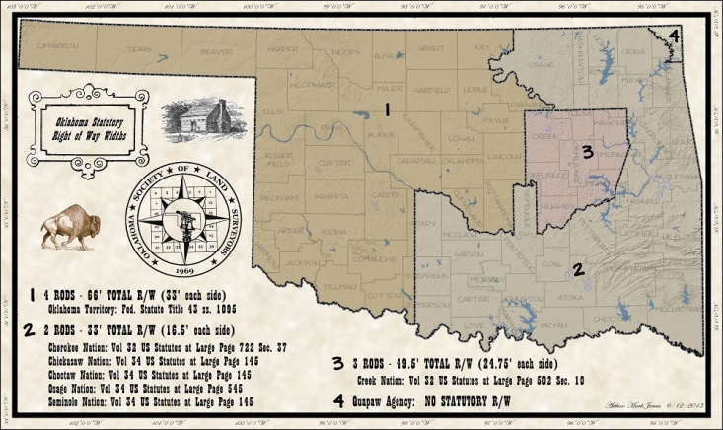
Public Land Survey System
Oklahoma Public Highways
4 rods wide in most areas
66 ft. total or 33 ft. on either side of each section line
Can be vacated…

Slide 35
Metes and Bounds
Describes the boundary of a parcel
Originally used natural or man-made features and may still use them

Slide 36
Metes and Bounds
Parts of a description
Point of commencement
Point of beginning
Corners
Length and direction of boundaries
Names of adjoining owners or features
Area

Slide 37
Metes and Bounds

Slide 38
Platted Subdivision
Subdivides a tract of land into numbered lots
Plats are filed differently than other instruments with the Clerk

Slide 39
Platted Subdivision
Taxes on the area to be platted must be pre-paid
Certain number of copies must be provided
Plat name cannot be duplicated
As a survey, it must meet minimum survey requirements

Slide 40
Platted Subdivision

Slide 41
Mixing Descriptions

Slide 42
Mixing Descriptions
Frisco Ridge Phase 3
Frisco Ridge Phase 2

Slide 43
Tax Descriptions
Abbreviation of a legal description for property tax system
Cleveland County
Tulsa County
Tulsa County

Slide 44
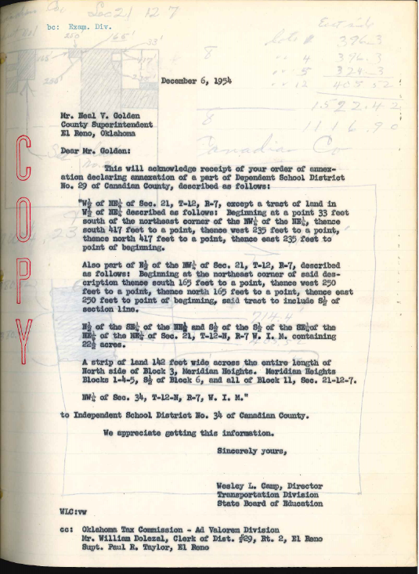
Other Uses for Legal Descriptions
Any man-made boundary or area must be defined
City Limits
School Districts
Counties
States

Slide 45
Creating Cadastral Maps
Start with a base map of some sort
PLSS information
Aerial photography
Any other information a legal description might reference

Slide 46
Creating Cadastral Maps
Individual Maps
In Oklahoma, each map typically represents a section or quarter section
Typically use standard scales
1 inch to 100 feet
1 inch to 200 feet
1 inch to 400 feet

Slide 47
Creating Cadastral Maps
Individual Maps
Don’t have to worry about fitting parcels to others on a different map
Sections or quarter sections might be “ideal”

Slide 48
Creating Cadastral Maps
GIS Parcel Data
One layer for entire jurisdiction
Parcels must fit with all others around them
Overall accuracy depends on base data accuracy

Slide 49
Creating Cadastral Maps

Slide 50
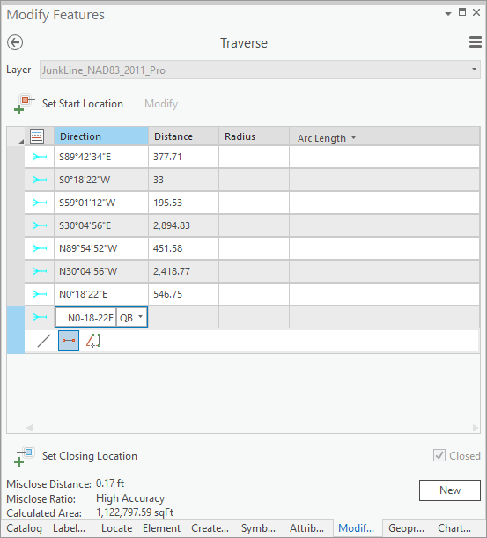
Creating Cadastral Maps

Slide 51
Fitting Descriptions Together

Slide 52
Fitting Descriptions Together
Measured metes with recorded metes

Slide 53
Fitting Descriptions Together
Measured metes with recorded metes

Slide 54
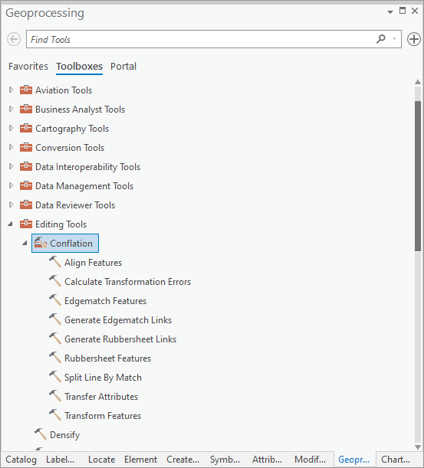
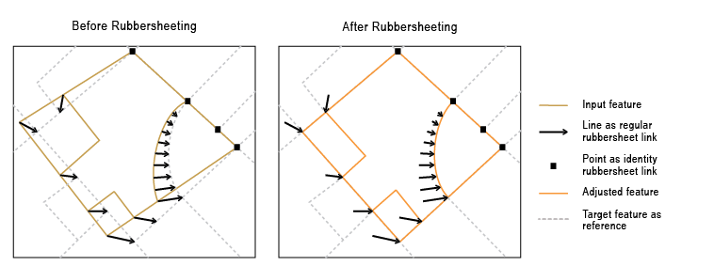
Fitting Descriptions Together
Tools for aligning features

Slide 55
Fitting Descriptions Together
Resolving Discrepancies
Senior Rights
Monuments (natural or manmade)
Adjoining Owners
Distance
Direction
Area

Slide 56
Parcel Data
Things to remember…
Parcel data cannot substitute for a survey
Parcel data has been fitted together as best as possible
Base data accuracy will effect overall accuracy

Slide 57
Questions & Contact Info
Tami Mohow
mohowt@canadiancounty.org
Joel Foster
fosterj@canadiancounty.org

