Slide 1
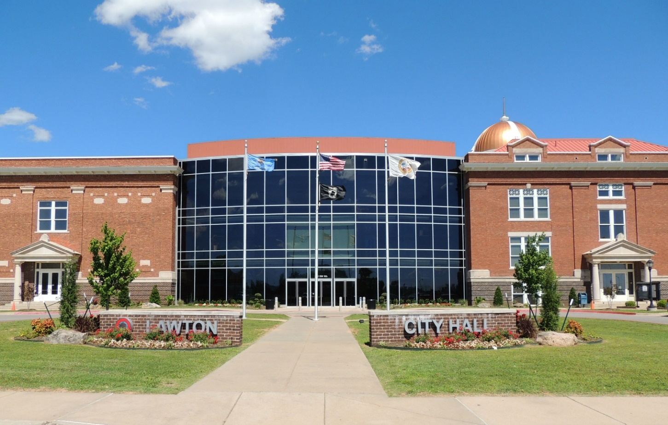
Making Lawton Beautiful
Judy Franco, GIS Developer
City of Lawton, OK

Slide 2
Mission: Engage our Citizens
Council wanted a way to get citizens involved in reporting nuisances in our city and invest in the community by making it beautiful.
1st step was to see what software packages were available to do this.
RFPs were sent out.
As they reviewed the RFPs, they realized the GIS will be an important part of implementing this service.
Once GIS was involved, we told them how we can save the city money by implementing an ESRI Solution.
Notes:
3 vendors responded ranging in cost from 12,000 to 50000, along with costing in average 10,000 per year for maintenance.

Slide 3
ESRI to the rescue
Downloaded Citizen Reporting Solution and tailored the solution to fit one of our divisions, Neighborhood Services.
Demo for City Manager, Council Member, and Neighborhood Services.
Started the pilot program that consisted of the City Manager, Council Member and Neighborhood Services Supervisor, which we fine tuned the solution to fit our needs and tested it for 2 months.

Slide 4
Implementation of iHelp Lawton
With the City Manager’s approval and City Council, iHelp Lawton launched June 10, 2019 accepting issues pertaining to Streets and Neighborhood Services.
We are at almost 500 issues reported to date.
Recently, we added two more divisions, Parks and Recreation and Solid Waste Collection.
The purpose of iHelp Lawton is to show our citizens the status of the issues they have submitted.

