Slide 1
City of Midwest City GeoHub
Gateway to Maps and Data for the Citizens of Midwest City

Slide 2
The Need
Outdated GIS page on City’s website.
Non ESRI web map application w/ limited function.
Single site for employee and citizen use.
Limitations to Portal and ArcGIS Online landing pages.
Notes:
MapViewer was not being updated, limited functionality compared to ESRI, features stopped working
Limitations – front page of each had limitations on content type and quantity.
Only way to see content was the Map gallery and custom html in page description

Slide 3
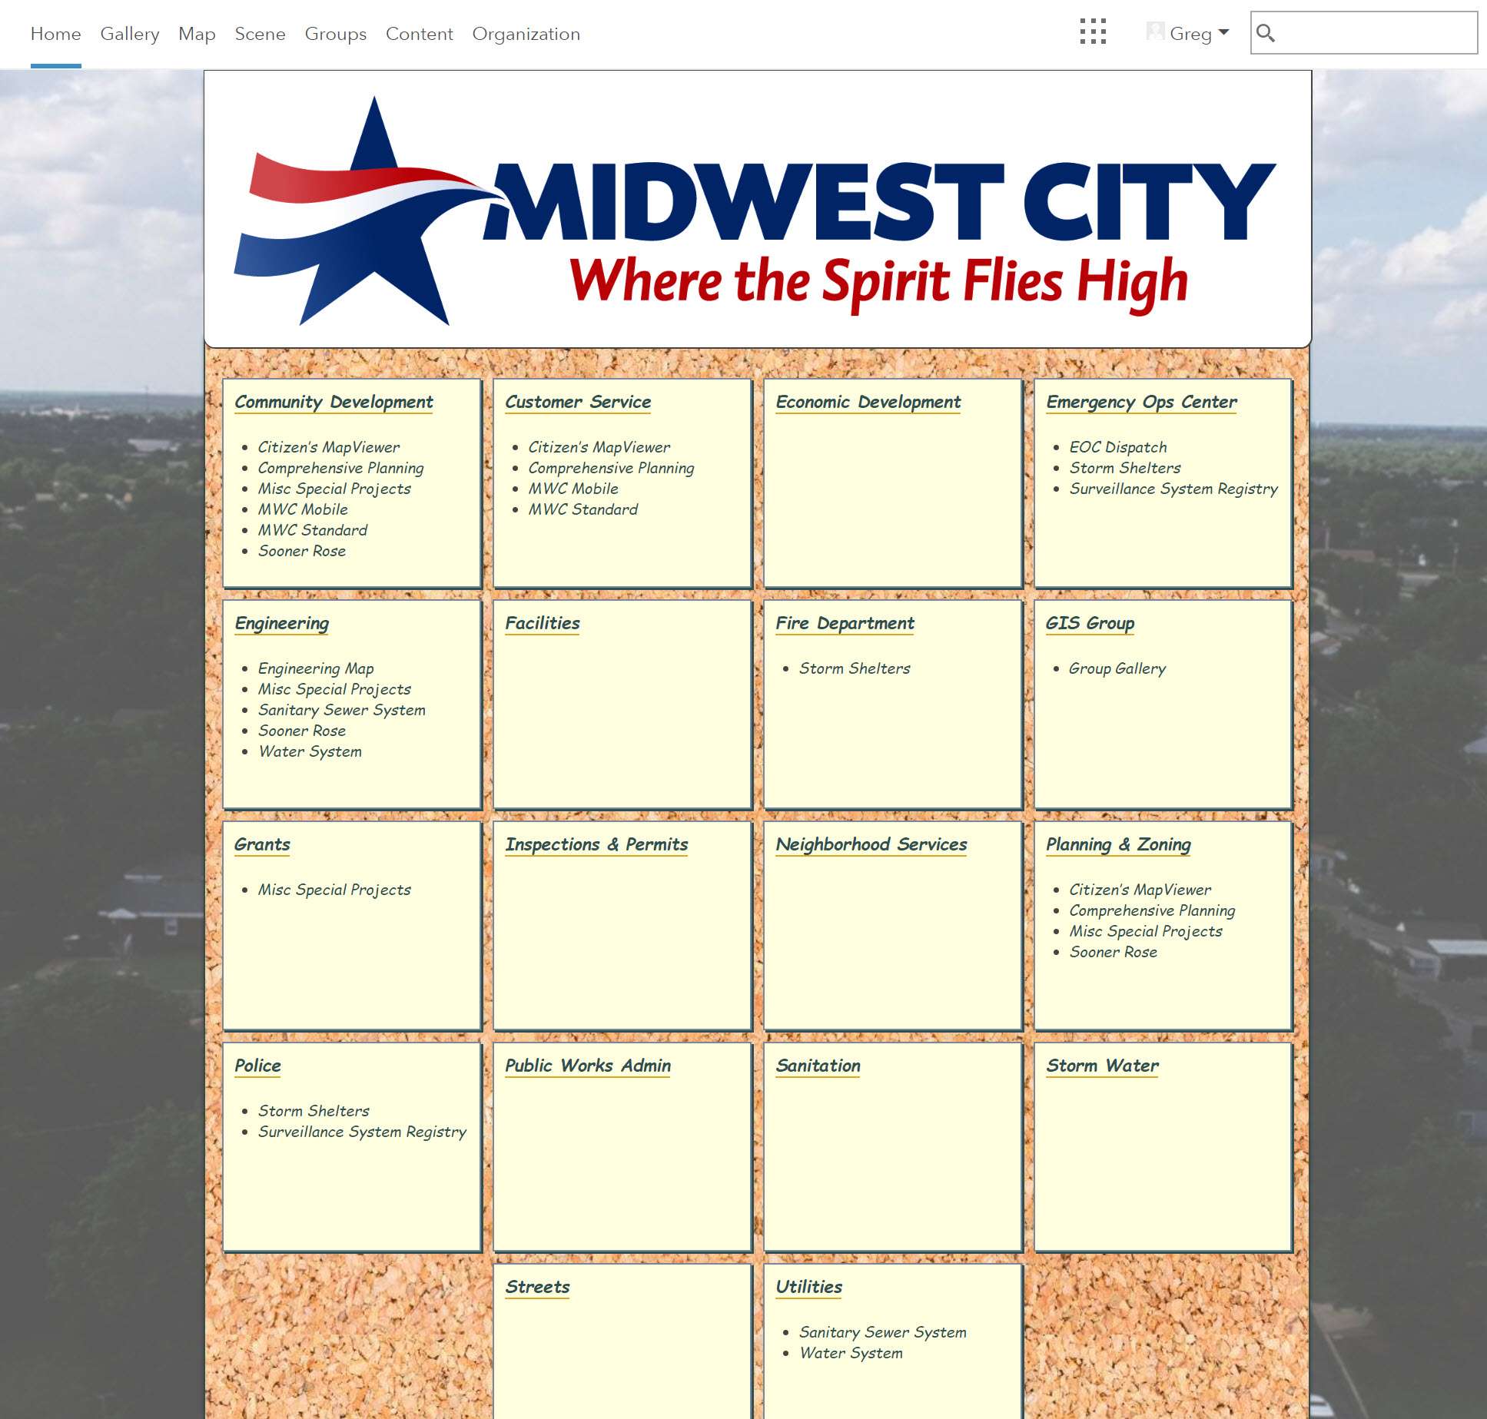
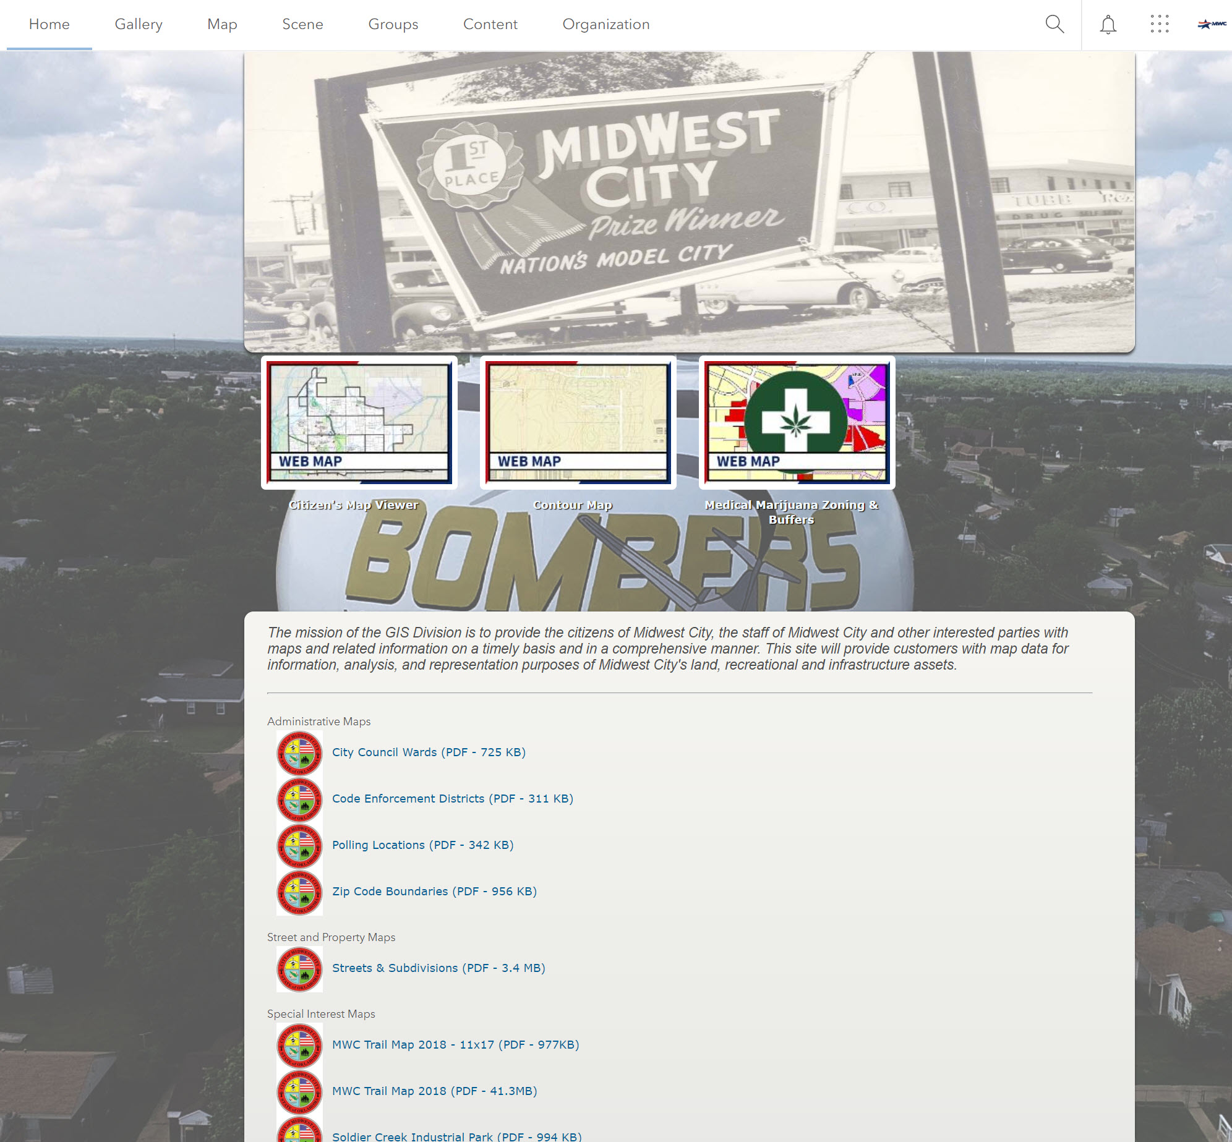
The Need
Portal
ArcGIS Online

Slide 4
The Result

Slide 5
Groups & Permissions Overview
Not all data and web products are relevant to every internal department and too many options at one time can distract from ease of use.
Share the same web application with multiple groups to reach more users.
Share one certain web application with a single group for security purposes.
More work up front leads to easier organization later on.
Easy to assign web application permissions to a new user by adding them to a single group. This has been essential while bringing municipal employees into the Organization.

Slide 6
Design Overview
Sites
Hyperlink
GeoHub
Fire Dept
Com Dev
Police
Map
Story Map
PDF
OpenData
Map
Map
Map
Map
Internal/Portal
External/AGOL
Notes:
With the creation of a one stop site, we needed to distinguish public vs private access and data
Private – ArcGIS Sites pages, department specific maps and applications, some maps have shared access between multiple depts
Public – GeoHub, web maps, Story Maps, social media, open data, pdfs, etc.

Slide 7
Page Building Overview

Slide 8
GeoHub Demo

Slide 9
Future Development
Additional web maps and applications for departmental Sites pages.
Develop and deploy Survey123 applications to engage MWC citizens.
Make adjustments as needed based on Google Analytics
Ability for community to request custom maps and data
Looking at paid version of Hub as a possible upgrade

