Slide 1
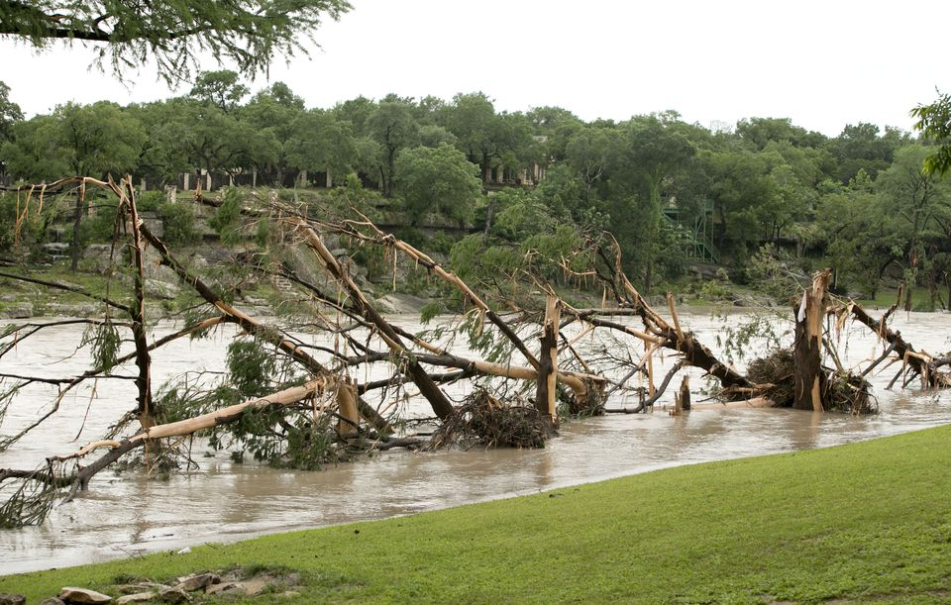
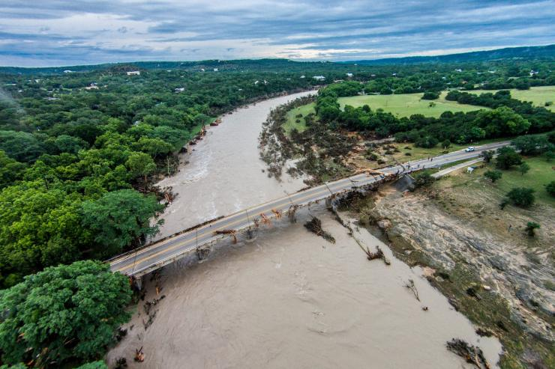
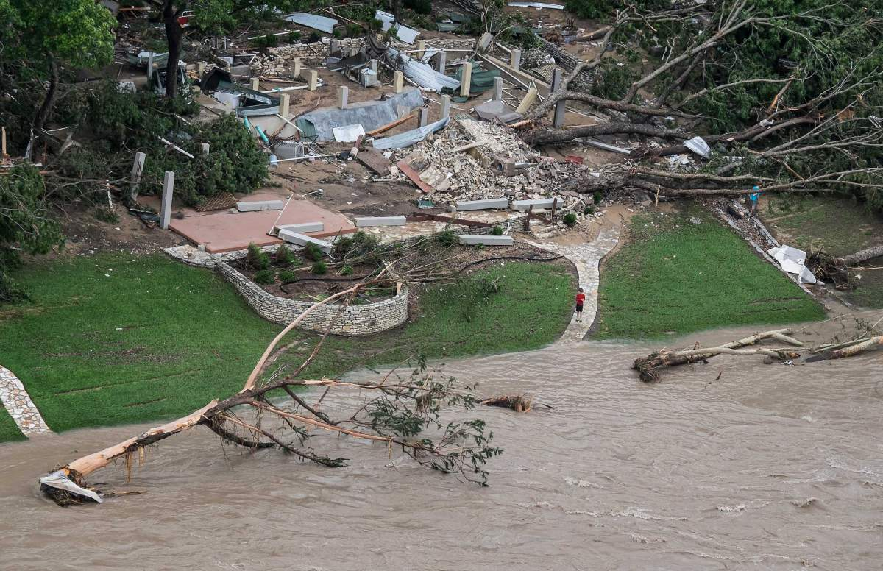
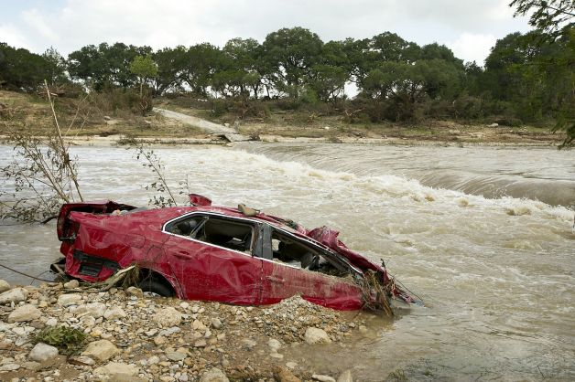
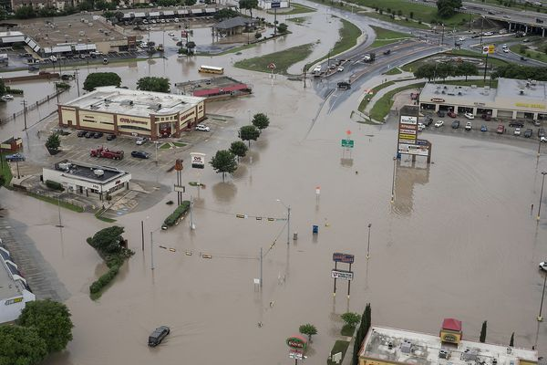
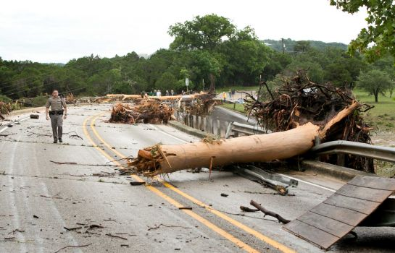
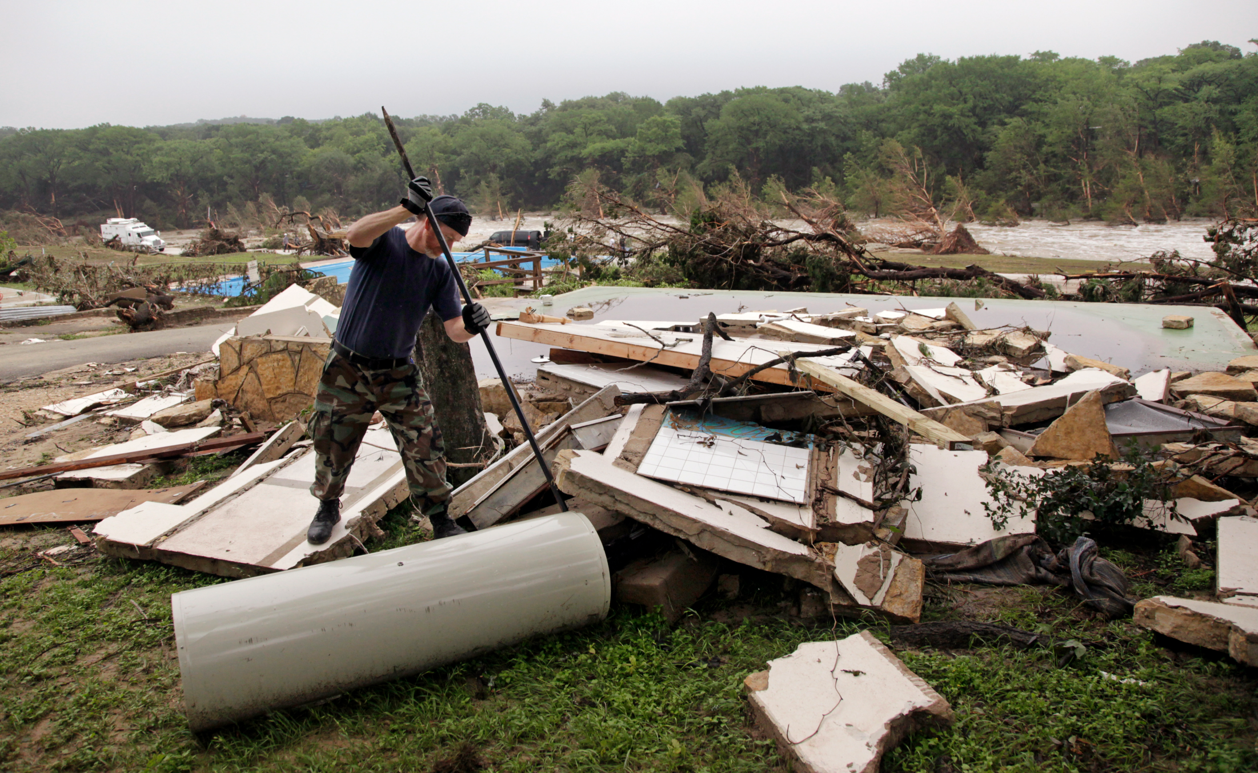
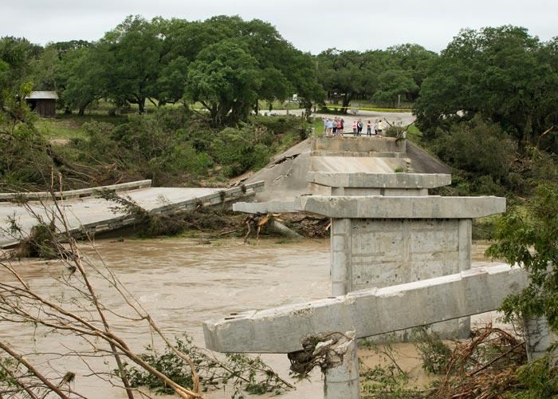
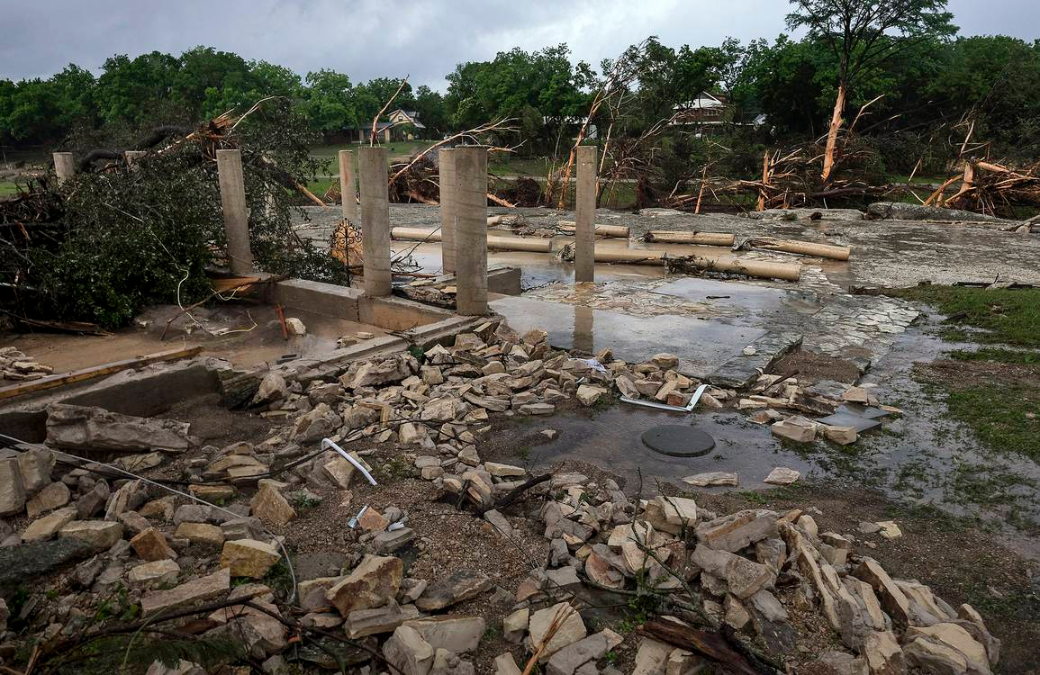
Increasing Situational Awareness of River Flooding by applying a GIS Extent Mapping Approach
OK-SCAUG 06/24/15
Jared Allen
NWS Austin/San Antonio

Slide 2
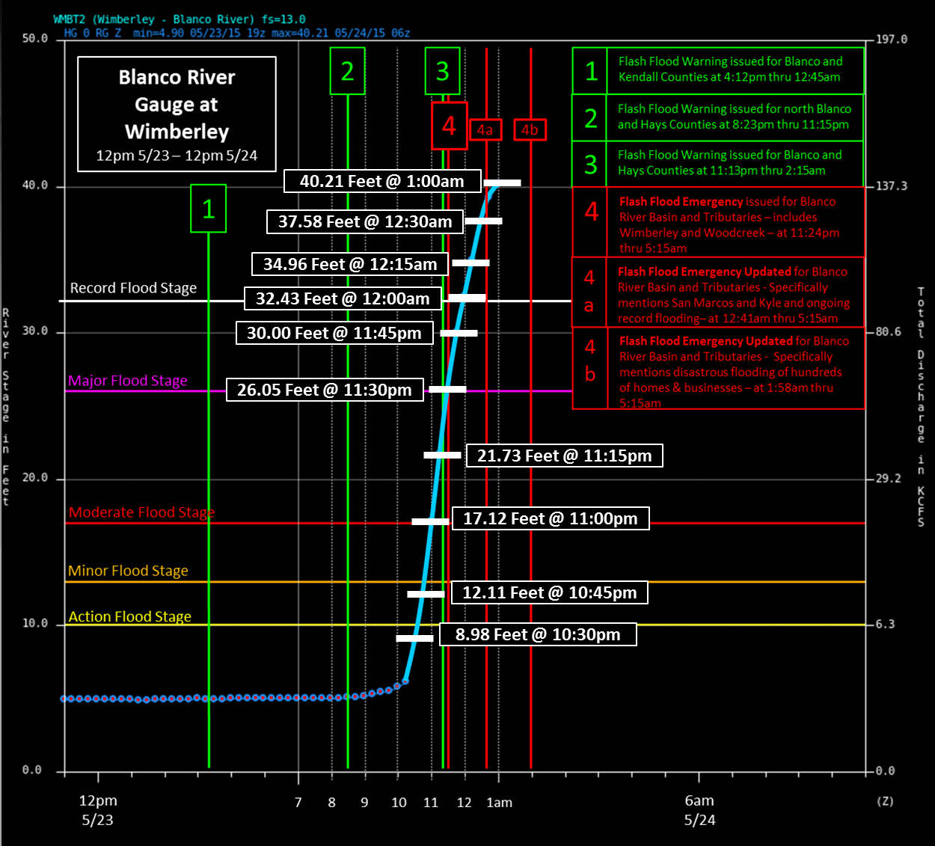
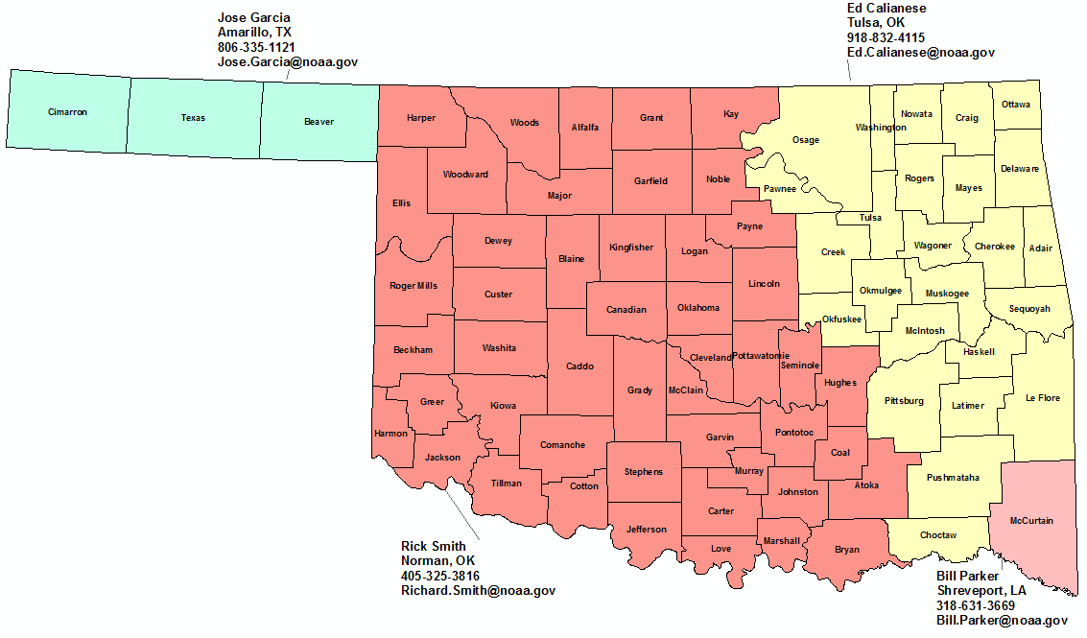
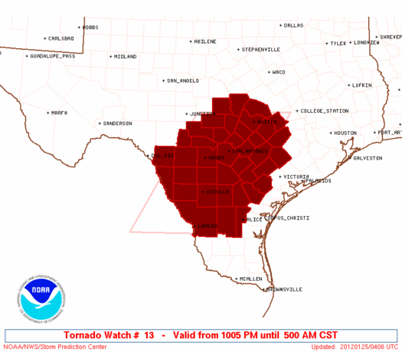
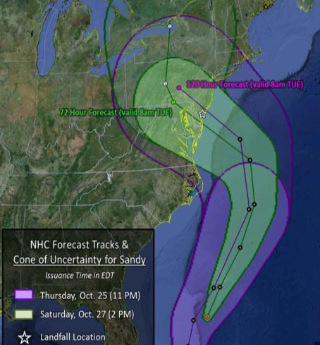
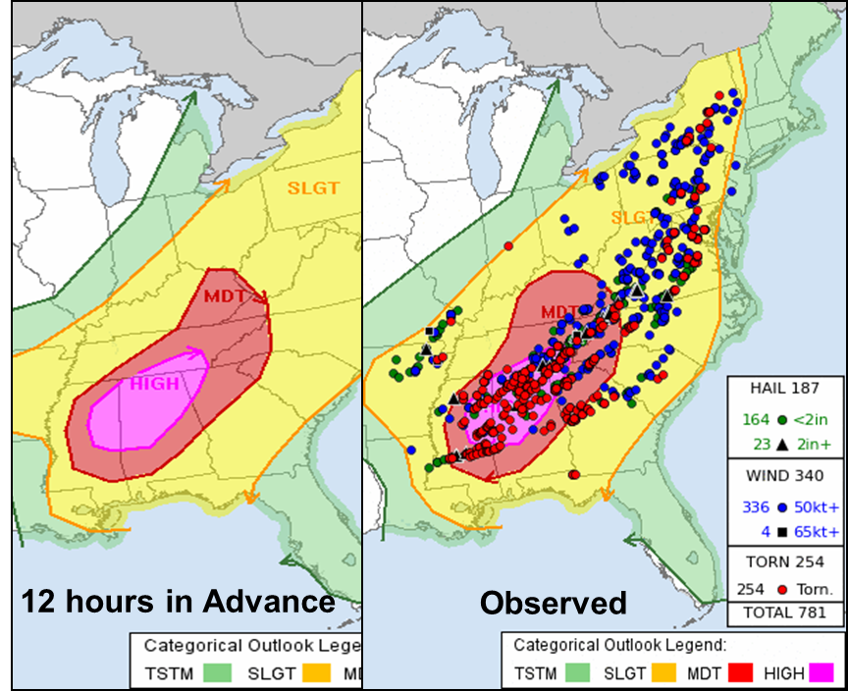
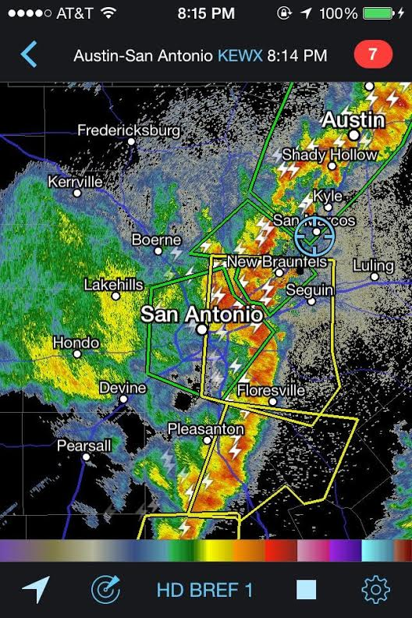
NWS Mission & Partnerships
Provide forecasts and warnings for protection of life and property.
Develop partnerships and relationships with City, County, State, and Federal agencies.
Sharing data
Sharing knowledge of local area
Mitigating hazards before they happen
NWS Norman & NWS Tulsa & NWS Amarillo (OK Panhandle)
Outlooks
Forecasts
Watches/Advisories
Warnings
Time
1-2 Weeks
1-7 days
6-36 hours
Hours - Minutes

Slide 3
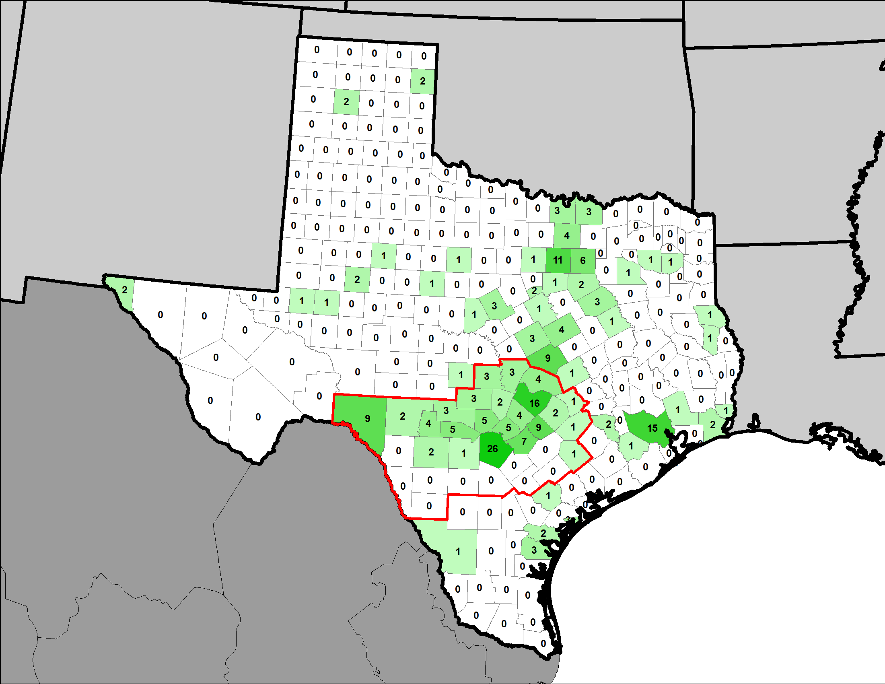
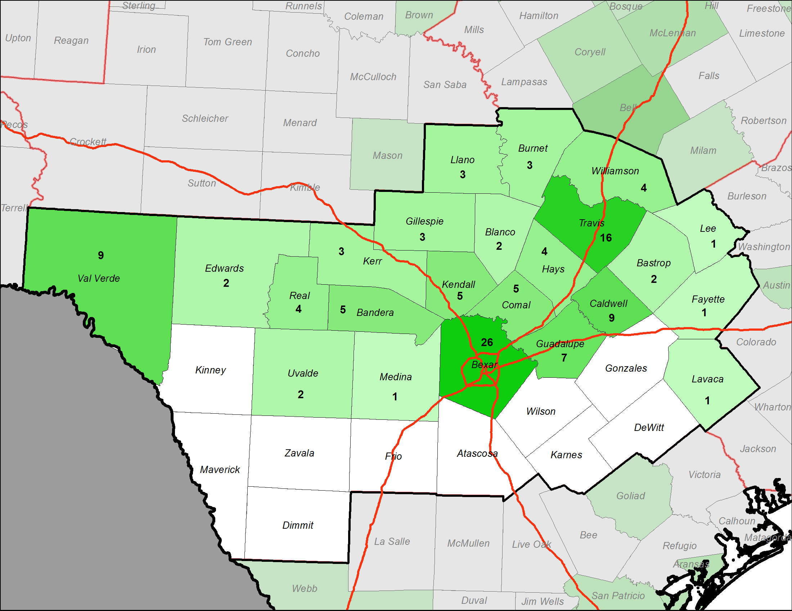
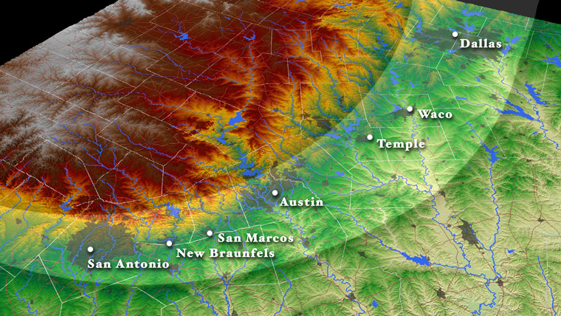
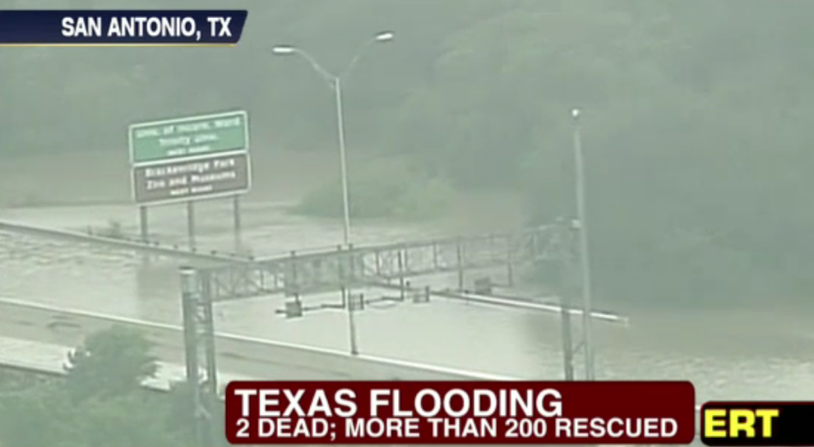
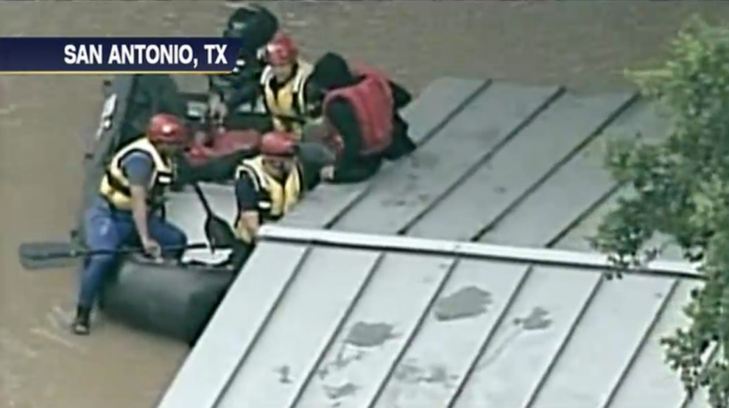
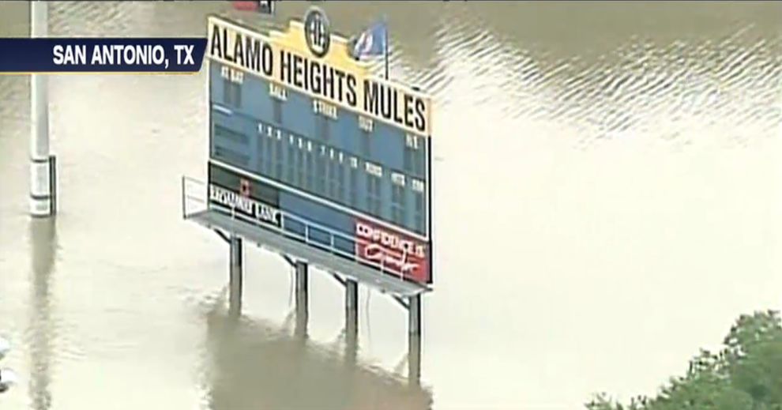
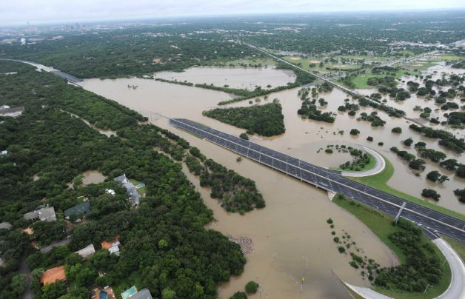
Record Setting Wet May
Flash Flood Fatalities 1996-2014
Flash Flood Fatalities 1996-2014

Slide 4
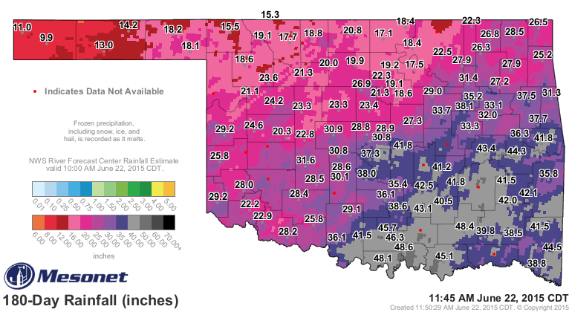
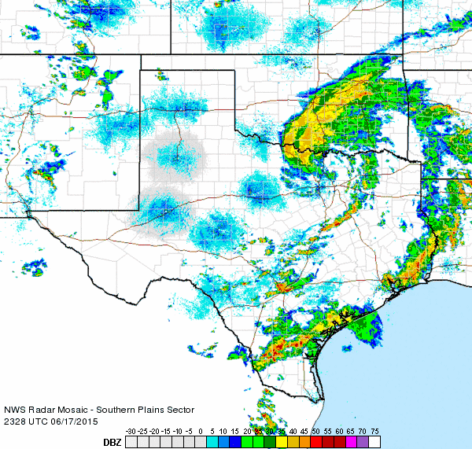
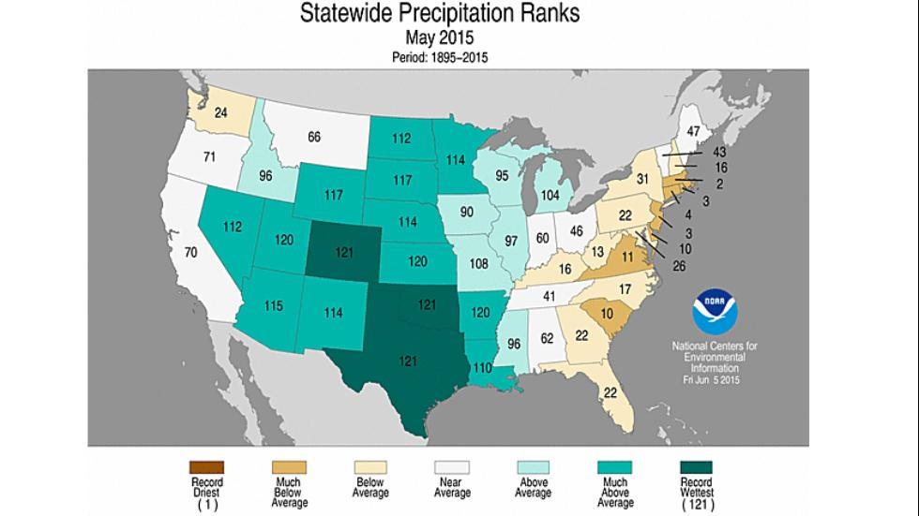
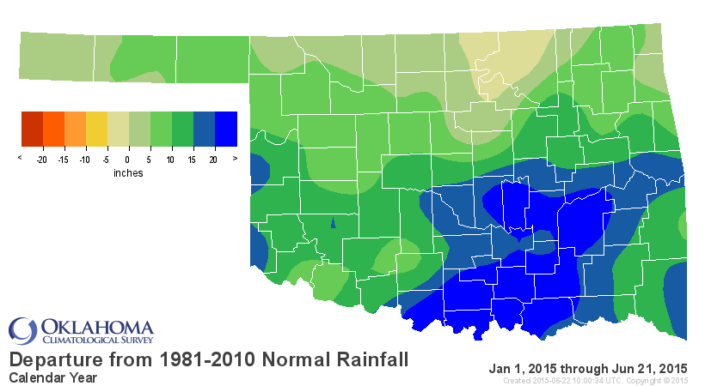
Record Setting Wet May (& June)
Greg Carbin, SPC

Slide 5
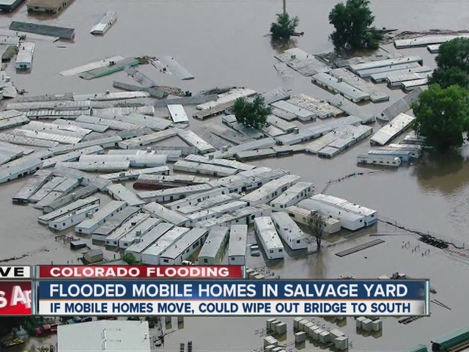
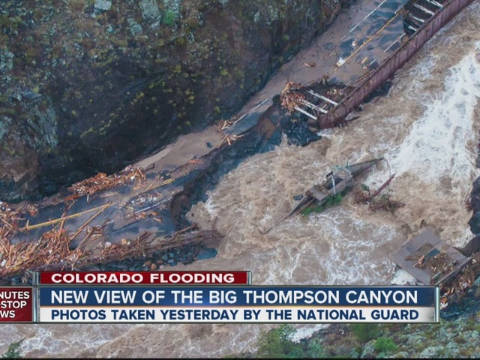
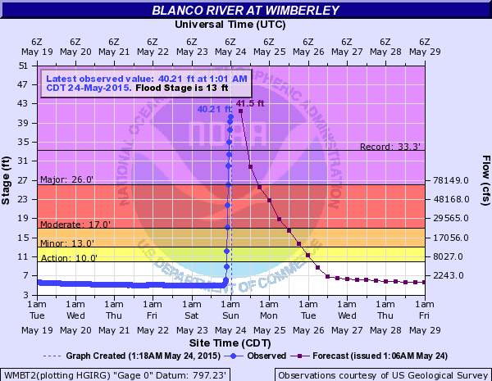
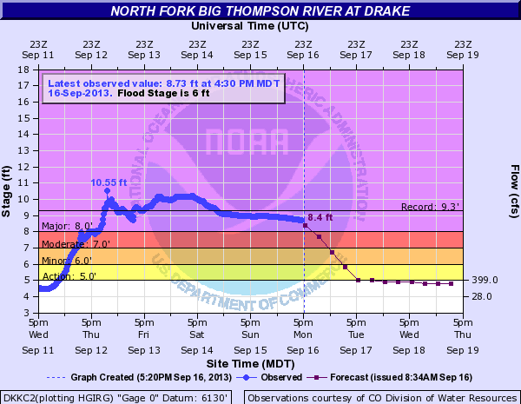
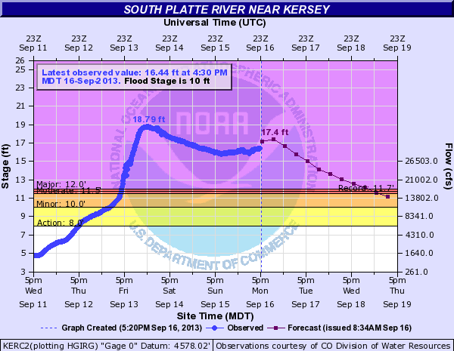
NWS Evolution of River Flooding Awareness
Video Link
1) Tables to Text
2) Tables to
Graphics

Slide 6
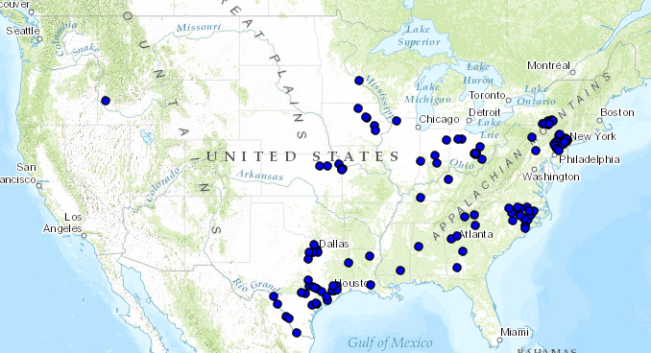
Evolution of River Flooding Awareness Continued
3) Flood Extent and Inundation Mapping
Still several issues:
There has to be a better Effort vs. Cost way!
Total of 127 gauge points completed since 2002 in response to inland flooding from Hurricane Floyd in 1999
Only 2% of gauge sites mapped
Money: $10,000 – $50,000⁸ per site
Time: 3 Months to 2 Years⁸ per site
Plus Stringent NOAA/NWS Guidelines
4) Push Maps to EMs, Media, Web, Facebook, Twitter

Slide 7
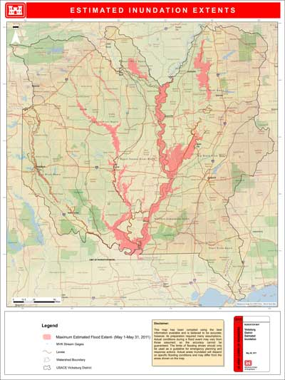
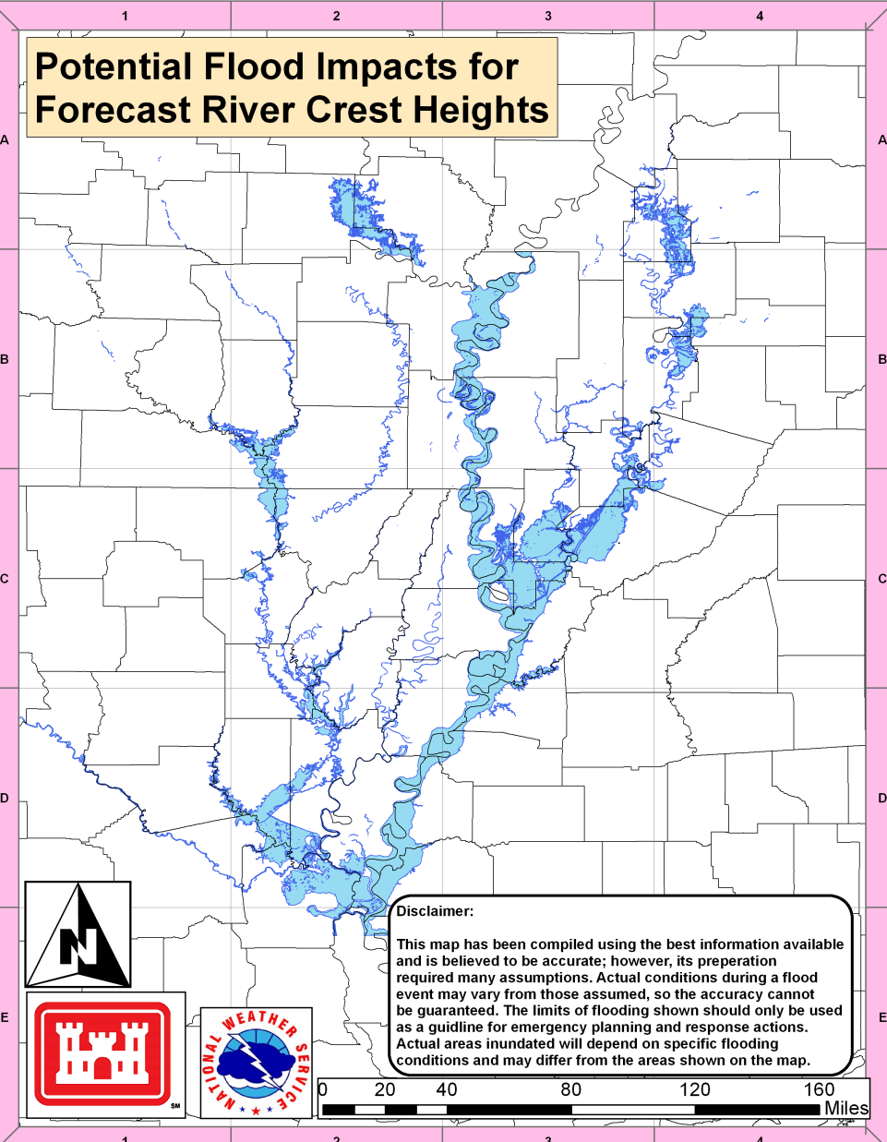
NWS/US Army Corps of Engineers Partnership
USACE Vicksburg, MS developed an in-house Flood Extent Simulation Model (FESM)
Used with great success during Mississippi River Flood 2011
Met with USACE VKS about project idea for specific river sites
NWS Jackson developed an in depth protocol for ArcGIS & FESM integration (V1.7)
Built a local team, became regional (LMRFC), and then sub-national (Hydrologic Branch at WSH HQ) team

Slide 8
River Flooding Extent Project Goals
Goal 1: To efficiently produce acceptably accurate flood extents for minor, moderate, major & record flood stages at and along river gauge sites (for a site specific distance) to aid both internal and external coordination and communication of the NWS with Federal, State, County and City officials, along with the general public.
Goal 2: To develop an intuitive internal & external dynamic web maps and information viewer displaying the flood stages.
Answer the questions of:
What does moderate flood stage mean to me?
What floods when the river reaches X feet?
What areas of my city/county need to be monitored or possibly evacuated based on the river forecast?
How much infrastructure is at risk if major flooding occurs?

Slide 9
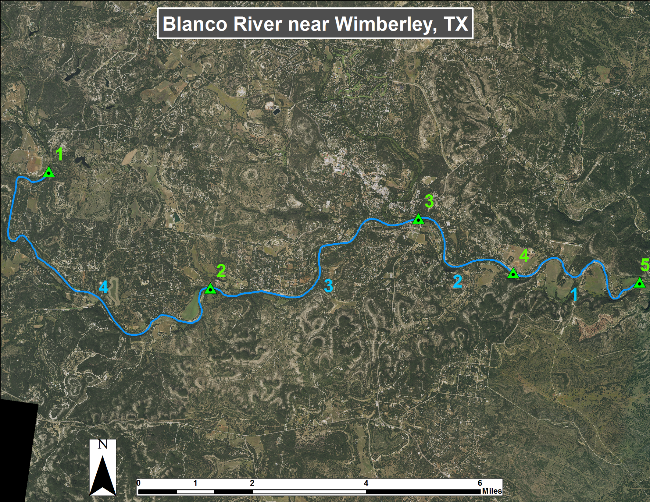
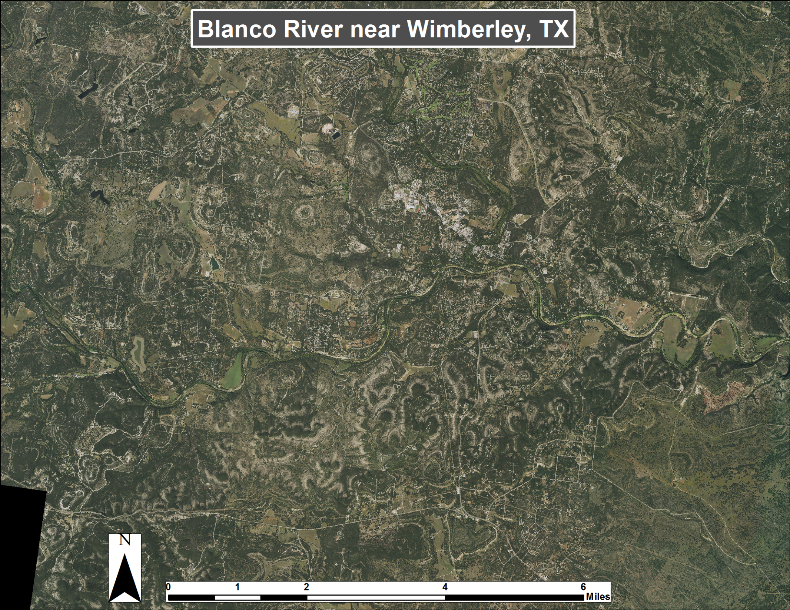
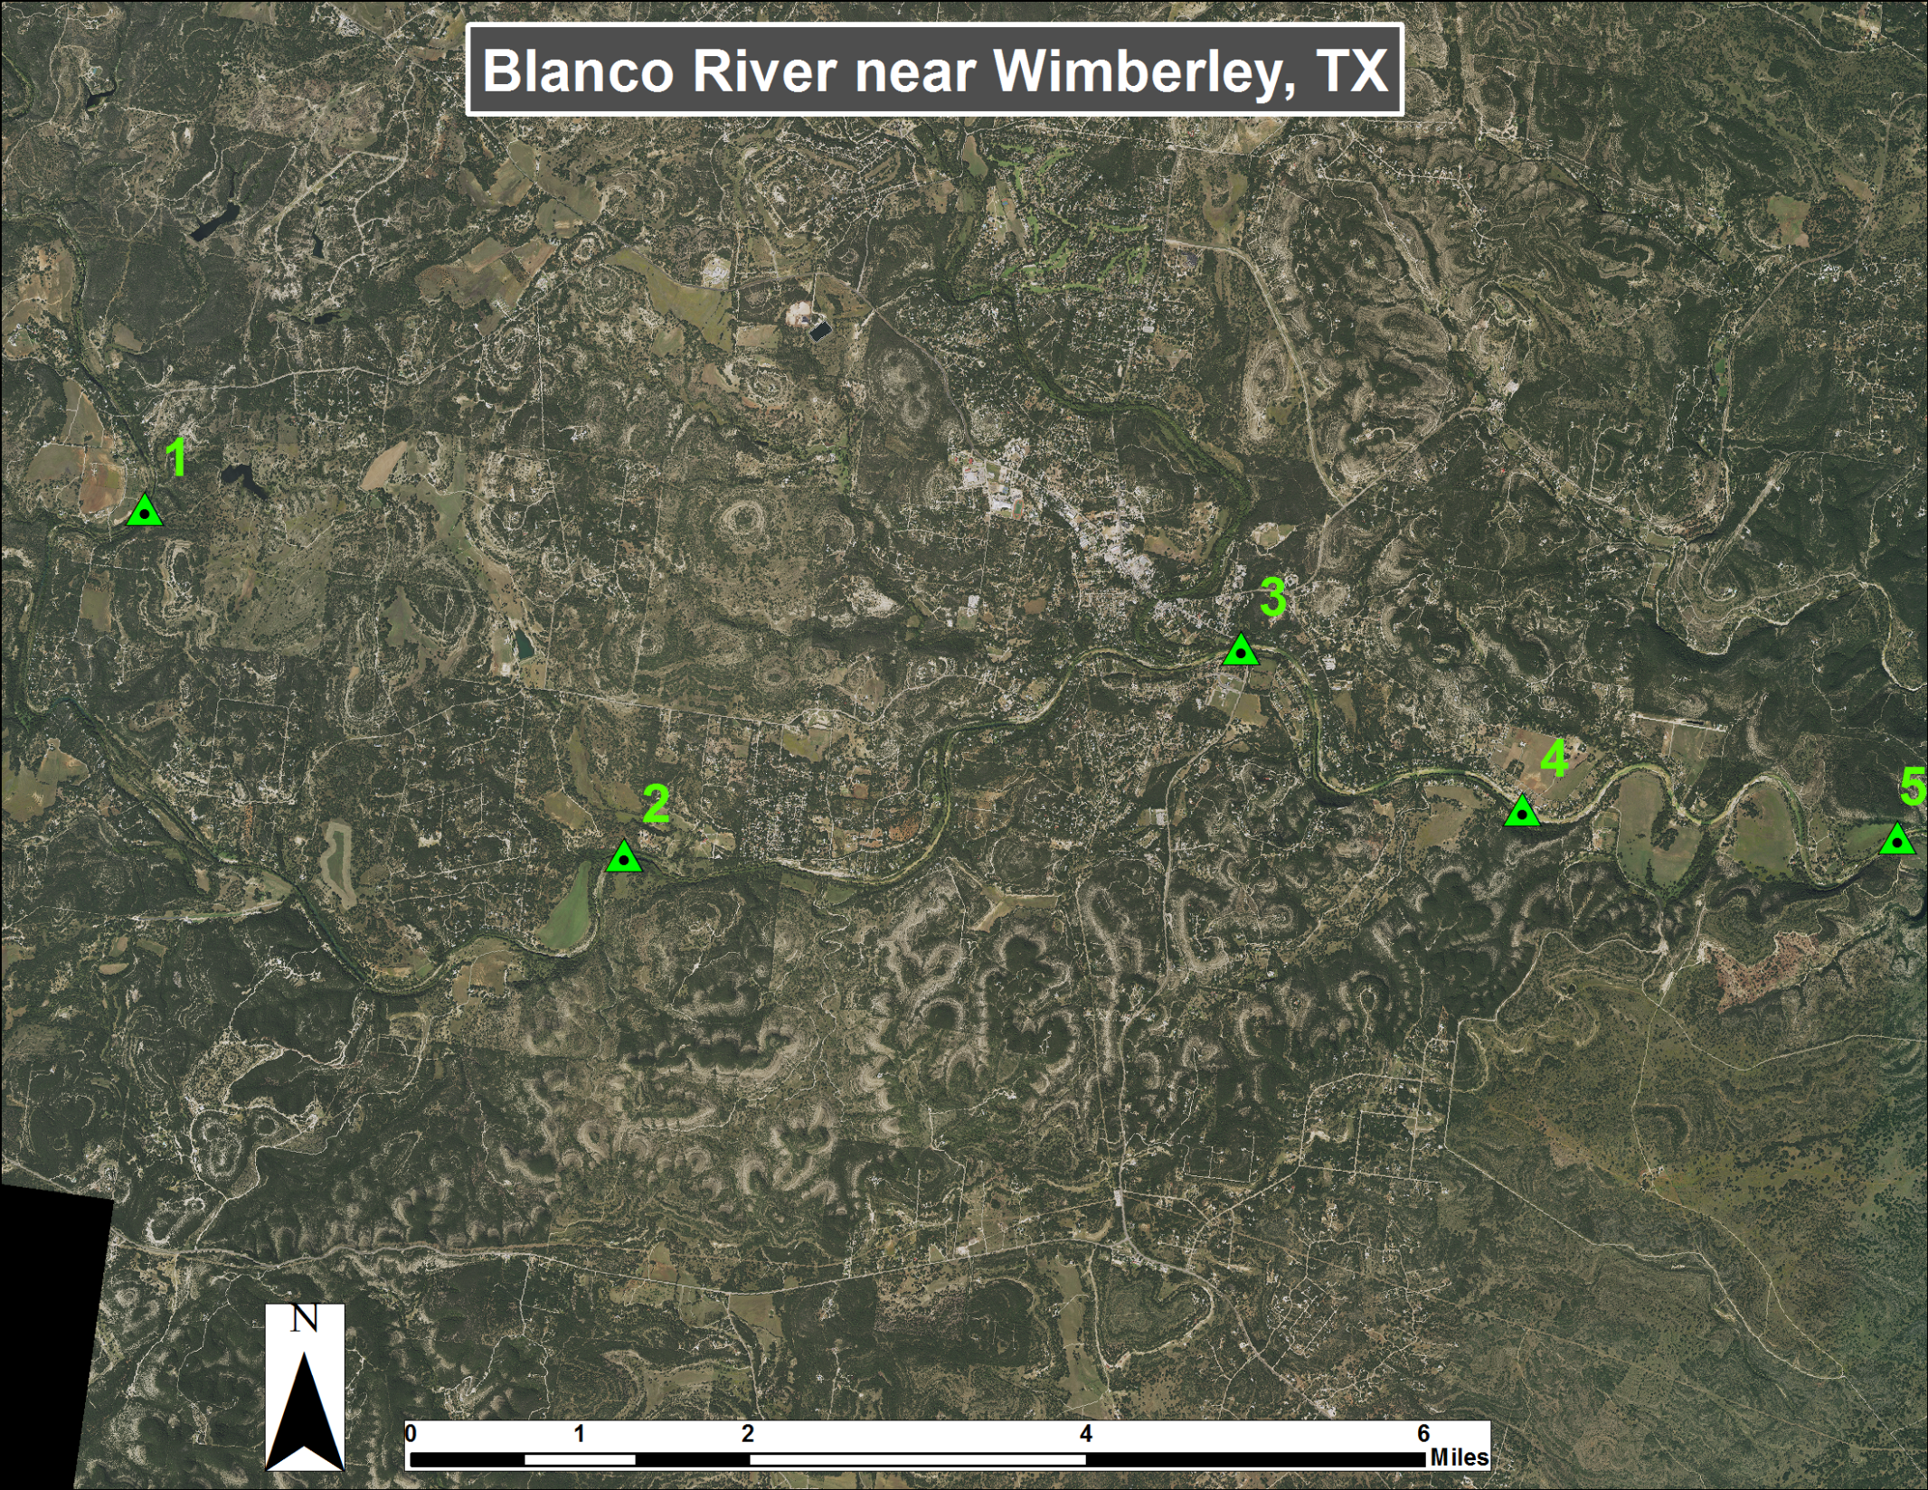
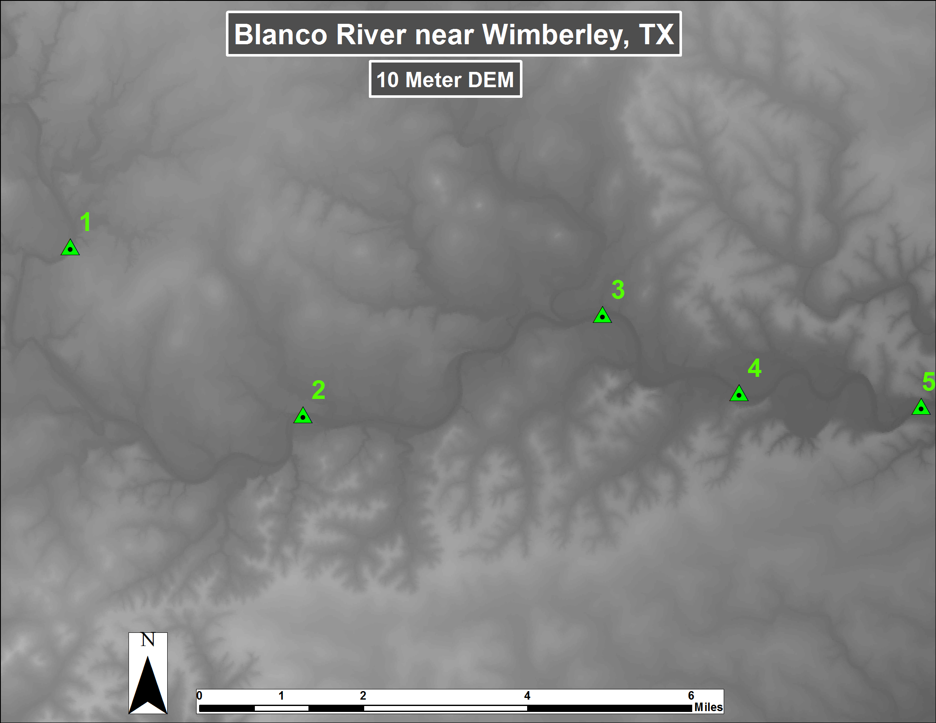
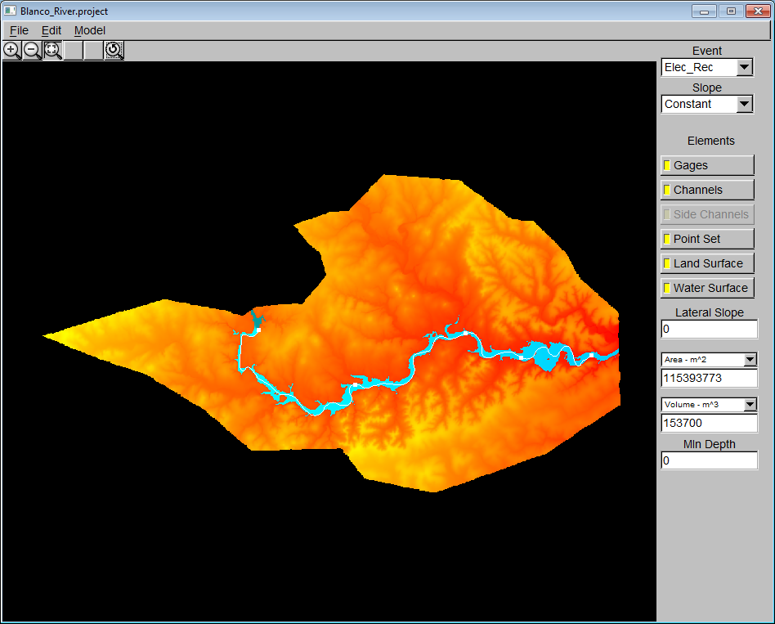
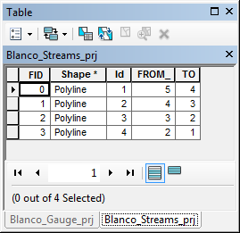
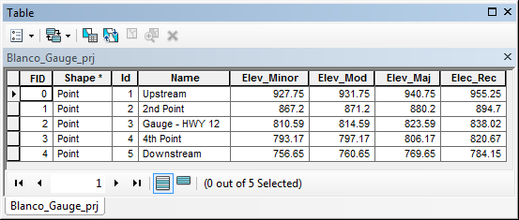
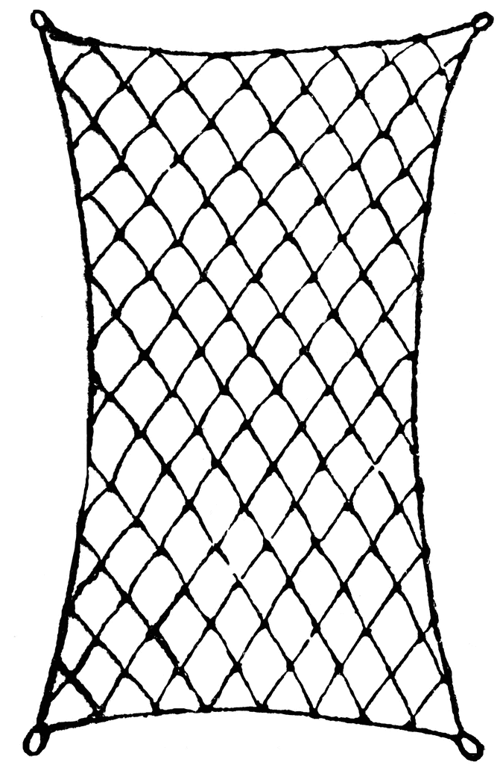
Project Methodology/Workflow
Place hypothetical gauge points upstream to downstream
Polyline Stream segments going from downstream to upstream
Phase 1 – Unedited Comparison
Minor
Moderate
Polygon to Raster
$$\frac{797.23 ft}{799.54 ft}=\frac{851.38 ft}{x ft}$$
Major
Record
Gauge 3 is an actual USGS/NWS River Gauge
Flood Extent Simulation Model
FESM Shapefiles in ArcGIS
0 | 10
1 | 12
Reclassify
Minor
Moderate
USACE FESM
Major
Record
Raster Calculator
10 | 12
11 | 13
Gauge & Stream
Shapefiles created
DEM & LiDAR Area Selected
Inputs: Gauge & Stream Shapefiles
DEM, LiDAR Data
AHPS Shapefiles in ArcGIS
Phase 2 – Edited Comparison
Minor
Moderate
Polygon to Raster
Unedited FESM Shapefiles
QC Filters in ArcMap
Major
Record
Need to account for vertical datum conversion as well (NGVD 1929 vs. NAVD 1988)
Using the known height of the USGS/NWS gauge, use proportions to calculate the other hypothetical gauge heights
Minor
Edited FESM Shapefiles in ArcGIS
0 | 10
1 | 12
Reclassify
Moderate
Minor
Moderate
Major
Raster Calculator
Major
Record
10 | 12
11 | 13
Record
High Water
Marks Match
(E19s)
FEMA DFIRM
Agreement
AHPS Shapefiles in ArcGIS

Slide 10
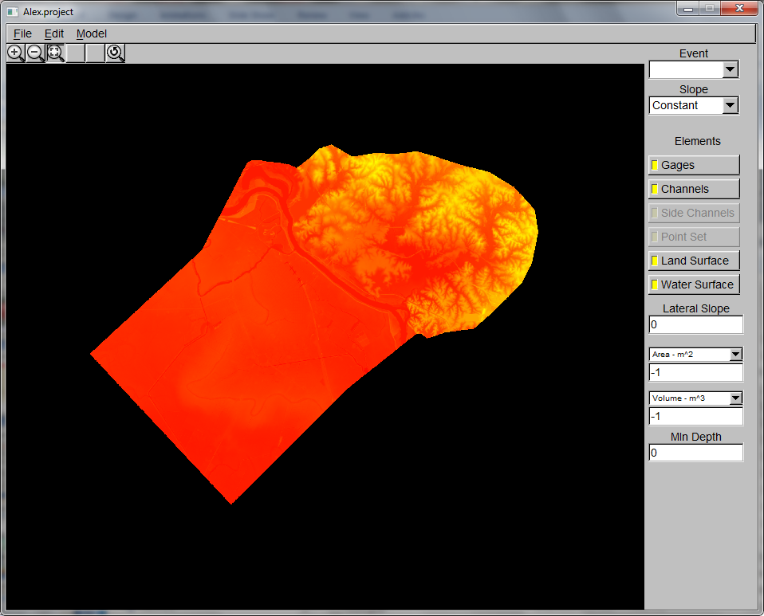
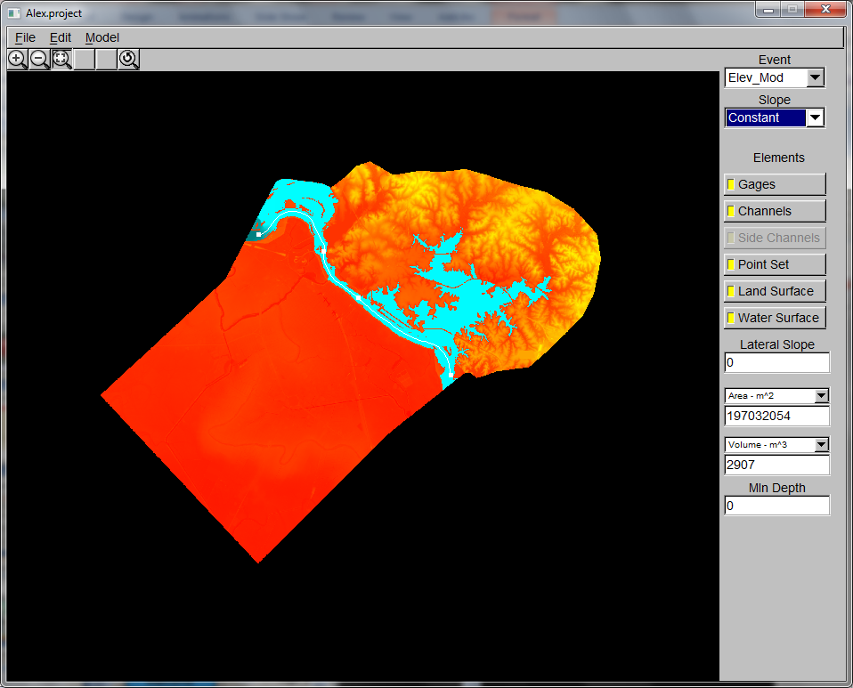
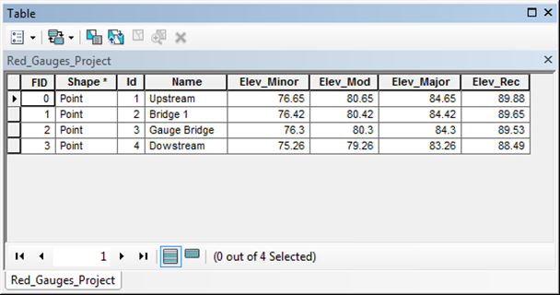
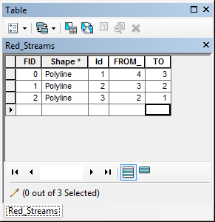
Project Methodology/Workflow
Phase 1 – Unedited Comparison
Minor
Moderate
Polygon to Raster
Major
Record
Flood Extent Simulation Model
FESM Shapefiles in ArcGIS
0 | 10
1 | 12
Reclassify
Minor
Red River
Moderate
USACE FESM
Major
Record
Raster Calculator
10 | 12
11 | 13
Gauge & Stream
Shapefiles created
DEM & LiDAR Area Selected
DEM, LiDAR Data Used
AHPS Shapefiles in ArcGIS
Phase 2 – Edited Comparison
Minor
Moderate
Polygon to Raster
Unedited FESM Shapefiles
QC Filters in ArcMap
Major
Record
Minor
Edited FESM Shapefiles in ArcGIS
0 | 10
1 | 12
Alexandria, LA
Reclassify
Moderate
Minor
Moderate
Major
Raster Calculator
Major
Record
10 | 12
11 | 13
Record
High Water
Marks Match
(E19s)
FEMA DFIRM
Agreement
AHPS Shapefiles in ArcGIS

Slide 11
Sites Modeled and Statistics
Six river sites tested at various elevation data resolutions:
River Site | LiDAR/DEM Resolution
Leaf River at Hattiesburg, MS | ~ 9 Feet (3 Meter) LiDAR
Susquehanna River at Binghamton, NY | ~ 6 Feet (2 Meter) LiDAR
Red River at Alexandria, LA | 20 Feet LiDAR
Susquehanna River at Harrisburg, PA | 30 Feet (10 meter) DEM
Kentucky River at Frankfort, KY | 5 Feet LiDAR
Onion Creek at Austin, TX | 30 Feet (10 Meter) DEM
Spatial Statistical tests performed:
Cohen’s Kappa Coefficient^{2,4}
Overall pixel classification accuracy⁶
Computed for: Minor, Moderate, Major, and Record stages

Slide 12
Cohen’s Kappa Coefficient
Assess inter-model reliability between two or more spatially observed/coded qualitative or categorical variables².
B
$$κ=\frac{\operatorname{Pr}\left(a\right)−Pr⁡(e) }{1−Pr⁡(e)}$$
 | Yes | No | Totals
Yes | 20 | 5 | 25
No | 10 | 15 | 25
Totals | 30 | 20 | 50
$\operatorname{Pr}\left(a\right)$ = Relative Observed Agreement
20 + 15 = 35 35/50 = 0.7
A
$\operatorname{Pr}\left(e\right)$ = Probability of Random Agreement
[(30/50) * (25/50)] + ([20/50) * (25/50)] = 0.5
$$κ=\frac{0.7−\text{0.5} }{1−0.5}$$
= 0.40

Slide 13
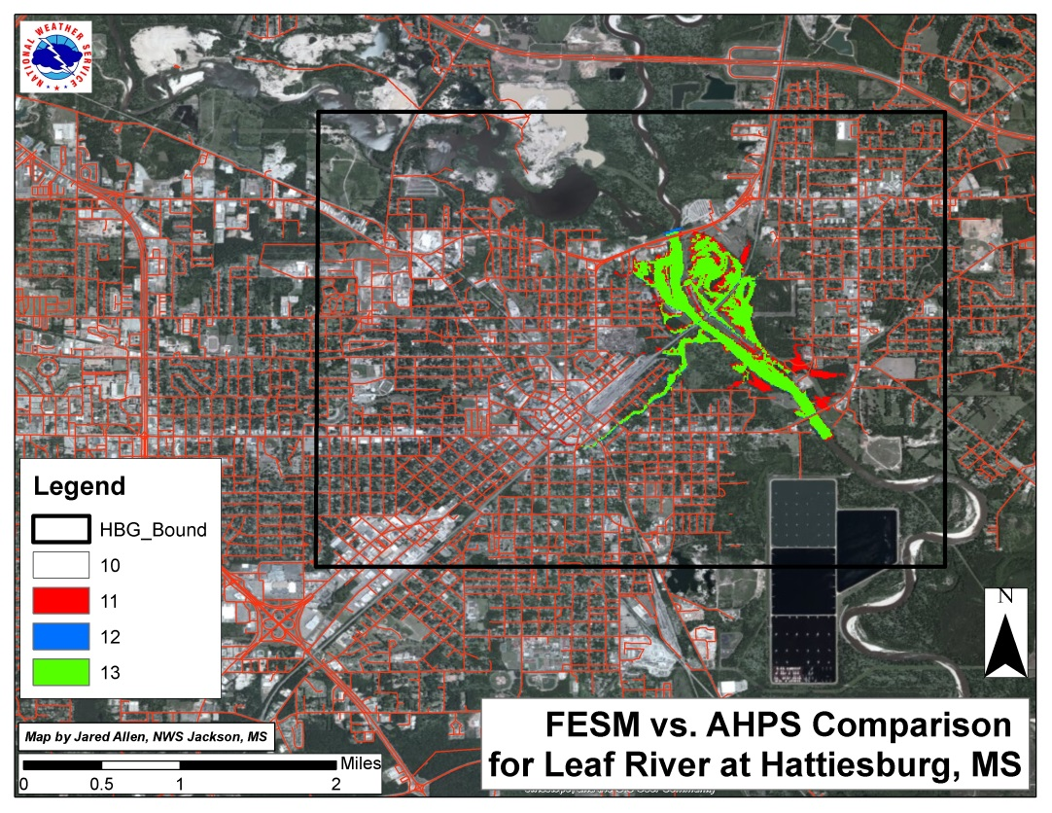
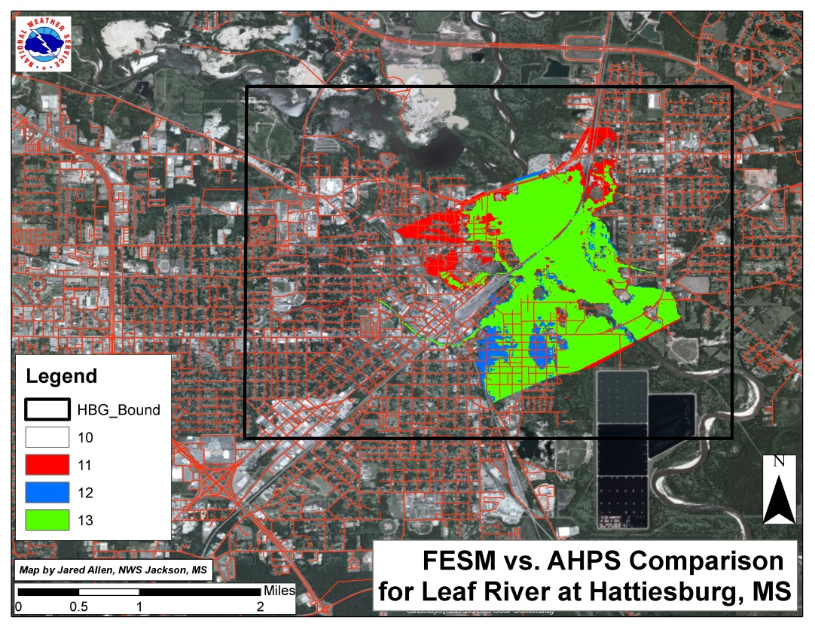
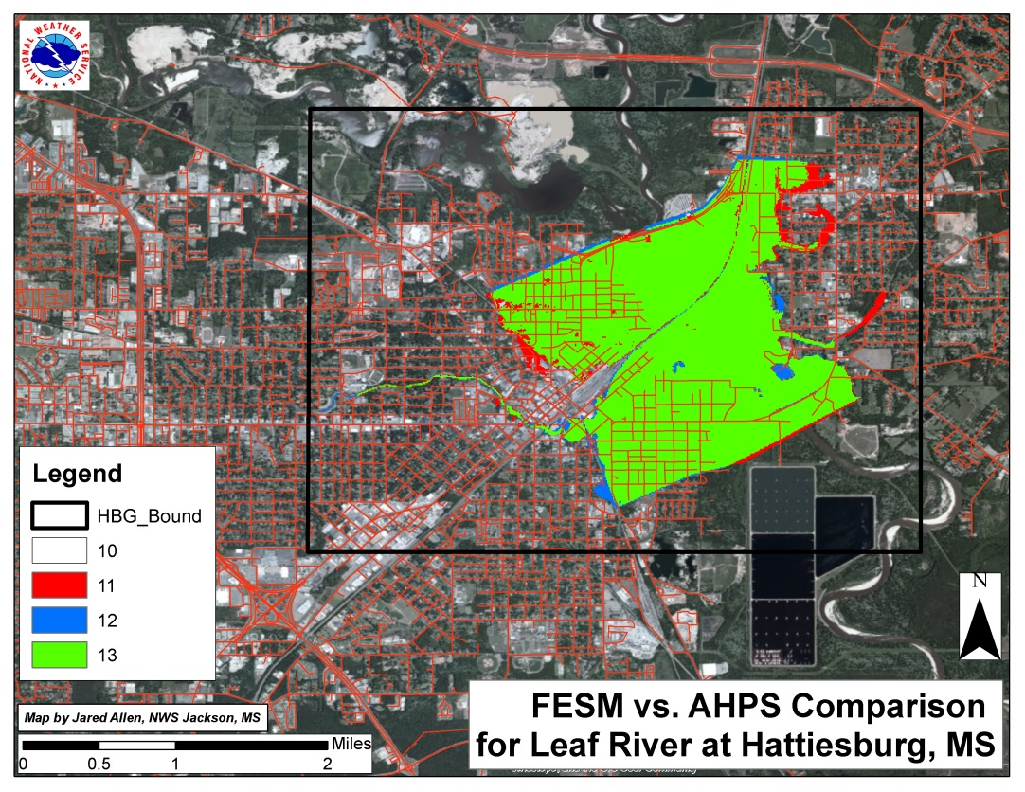
Minor
Moderate
Ƙ = 0.81
Ƙ = 0.82
Major
Record
Ƙ = 0.82
Ƙ = 0.97

Slide 14
Results
Fig. 1
Fig. 2
HEC-RAS Modeling Issues
HEC-RAS Modeling Issues
Flood Wall & Backwater Flooding
Flood Wall & Backwater Flooding
Flood Walls
Backwater Flooding
Flood Walls
Backwater Flooding
Unedited FESM Flood Extents had substantial to near perfect agreement.
Record Stage performed the strongest on average across all sites (Austin, TX outlier)
Moderate Flood Stage was weakest on average across all 6 sites (moderate agreement)
Using water impact location descriptions & FEMA DFIRM maps, edited flood extents (Fig. 2) had near perfect to substantial agreement.
Excluding the minor and moderate stages for Frankfort, KY (High substantial agreement)
Kappa could be raised further with local knowledge of Trumbo Bottom Area.
Significant improvement for Alexandria, LA site in Bayou Maria Basin
Moderate Flood Stage still lowest on average but above 0.8 (near perfect)

Slide 15
Flood Pixel Classification Accuracy
FCA = Pixels of Flood_{Correct}
(Pixels of Flood_{Correct} + Pixels of Flood_{Omission} + Pixels of Flood_{Commission} )
A series of flood classification accuracy graphs comparing unedited FESM Extents and edited FESM Extents against the accepted AHPS Extents were generated for:
- Minor - Moderate - Major - Record

Slide 16
0.79
0.78
0.68
0.64
0.85
0.85
0.80
0.74

Slide 17
Conclusions
FESM/ArcGIS Methodology deemed spatially accurate
Effort vs. Cost Analysis
70-98% FCA accurate and acceptable statistically
Completed in a week or less (starting from scratch)
With data in place & practice, can be as fast as 1-3 hours for raw flood area output & no QC
Mapping Accuracy & Kappa can be successfully increased through quality control measures:
Set to match current Impact Statements – E19s
FEMA DFIRM Data
River Forecast Center Agreement
Emergency Manager & Local Water Authority Agreement
Future Work
Test more sites with current methodology
Quantify QC improvements thru Classification and Kappa values
Develop internal AGOL website for critical partner access.

Slide 18
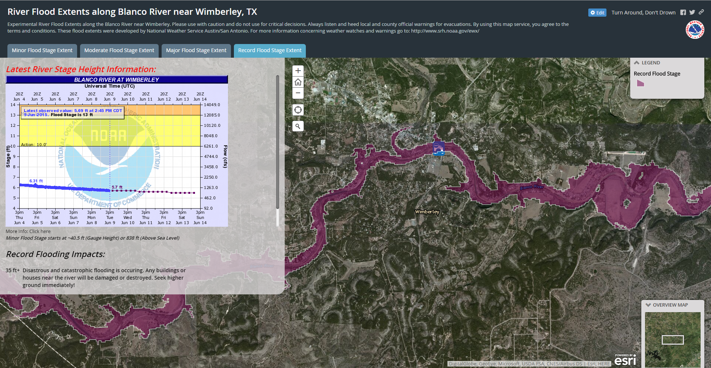
ArcGIS Online Integration
River Flooding Situational Awareness

Slide 19
Online Flood Extent Viewer

Slide 20
Critical for:
Key Decision Timelines
People and Resource Allocation
EOC Awareness & Service ^{1,7}

Slide 21
Thank You!
Jared Allen
Meteorologist/GIS – NWS Austin/San Antonio
Email: Jared.Allen@noaa.gov
NWS Norman Contact
Rick Smith – Warning Coordination Meteorologist
Email: Richard.Smith@noaa.gov
Cited Sources:
Gall, M., Boruff, B., and Cutter, S. (2007). ”Assessing Flood Hazard Zones in the Absence of Digital Floodplain Maps: Comparison of Alternative Approaches.” Nat. Hazards Rev., 8(1), 1–12.
Jeffrey D. Colby, Karen A. Mulcahy, and Yong Wang, 2000. Modeling flooding extent from Hurricane Floyd in the coastal plains of North Carolina. Global Environmental Change Part B: Environmental Hazards. 2(4), 157-168. http://dx.doi.org/10.1016/S1464-2867(01)00012-2.
Michener, William & Houhoulis Paula. “Identification and Assessment of Natural Disturbances in Forested Ecosystems: The Role in GIS and Remote Sensing.” 1995 (http://www.ncgia.ucsb.edu/conf/SANTA_FE_CDROM/sf_papers/michener_william/michener.html)
Short, Nicholas. Accuracy Assessment. (http://www.fas.org/irp/imint/docs/rst/Sect13/Sect13_3.html)
Qi, S., Brown, D. G., Tian, Q., Jiang, L., Zhao, T., & Bergen, K. M. (2009). Inundation Extent and Flood Frequency Mapping Using LANDSAT Imagery and Digital Elevation Models. GIScience & Remote Sensing, 46(1), 101-127.
Viera, Anthony, MD & Garrett, Joanne, PhD. “Understanding Interobserver Agreement: The Kappa Statistic.” Family Medicine. May 2005. (http://www1.cs.columbia.edu/~julia/courses/CS6998/Interrater_agreement.Kappa_statistic.pdf)
Wilson, M. D., & Atkinson, P. M. (2005). The use of elevation data in flood inundation modelling: a comparison of ERS interferometric SAR and combined contour and differential GPS data. International Journal of River Basin Management, 3(1), 3-20.
Weiger, Ben. NWS Flood Inundation Mapping Services, 2008. Bayou Vermillion River Conference. (http://www.srh.noaa.gov/media/lch/outreach/052808/6BenWeiger.pdf)

Slide 22
To Find Cohen’s Kappa:

Slide 23
AHPS
Grid = 0
Grid = 1
Grid = 0 & 1
Reclassify Raster
Reclassify Raster
Mosaic to New Raster
Mosaic to New Raster
FESM
Grid = 10
Grid = 12
Grid = 10 & 12

Slide 24
Raster Calculator: Add the two Images together
Pixel Value | AHPS Flood | AHPS No Flood
FESM Flood | 13 | 11
FESM No Flood | 12 | 10
Four Number Combinations Possible:
10 – Both Agree No Flooding
11 – Flooding in AHPS but not in FESM
12 – No Flooding in AHPS but Flooding in FESM
13 – Both Agree Flooding

