Slide 1
Essential Skill-sets
for GIS Professionals:
What Employers Desire.
Presented By:
Thomas E. Tollett, GISP
GIS Specialist
Corporate Cartography

Slide 2
The purpose of this talk is to help current students and recent graduates gain insight into skills professional habits that they may or may not gain from their formal education. These skill sets will be useful in during their career as well as valuable to prospective employers.

Slide 3
Anyone looking at job postings lately? Just surfing the net to see what's out there?

Slide 4
Seeing much variation in Job Descriptions, Salaries, and/or Job Titles? Lately I have noticed that these are falling more into line than in the past.

Slide 5
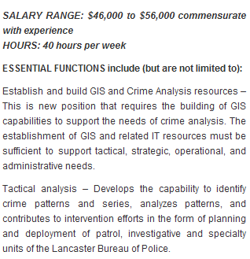
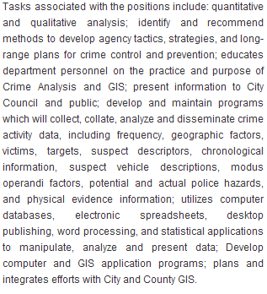
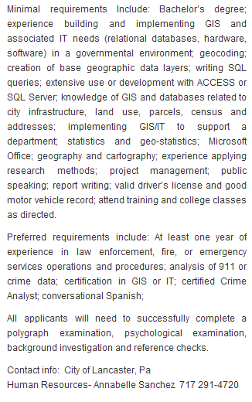
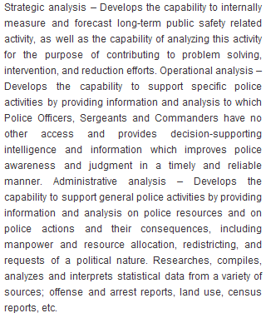
Example of an Current Job Posting…
Salary Range
(Not so)
Minimal Requirements
Essential Functions
Preferred
Requirements
Found on GISLounge.com
Posted on October 14th, 2009

Slide 6
The good news is that in 2008 the US Department of Labor listed “Geospatial Technology” as one of three emerging industries with the highest demand for workers and potential for growth in the coming decade.

Slide 7
The bad news is that it was listed by the US Dept. of Labor before the “Economic Downturn”.

Slide 8
Things are still going well for us, but it might take a few years for the opportunities to get back to where they were. (Look at it this way, you could be in Finance or finishing up a MBA….)

Slide 9
So, you have a Degree. Now what…
Remember, when you pass through the doors of the Carto/Geo Lab for the last time, your learning has really just begun.
You have chosen to enter into one of the fastest evolving career fields today. The analyses are getting more detailed, the software is becoming more powerful, and the hardware is growing more accurate with each iteration.

Slide 10
GIS and Geospatial Technology are gaining recognition in today’s workplace. Employers are beginning to realize what GIS can do for them, and are better versed in knowing what to looking for in potential employees.
While they do still ask for “the world” when it comes to skills, many are just looking for a good fit for their team.

Slide 11
Here at East Central, you have been provided with a good foundation to begin your Geospatial career.
In my not so humble opinion, one of the best foundations available in the State of Oklahoma for geospatial technology.

Slide 12
When starting out in your career, your main obstacle to overcome is the initial lack of experience.
Making the internship a mandatory part of the curriculum here at ECU should help ease that transition from the classroom into the workforce.

Slide 13
Job Titles are going to vary, mainly dependant on the realm you work in (Public, Private, or Non-Profit) and if that realm/business has an agreed upon nomenclature and grade scale. The secret that I have found is not to pay as much attention to the Job Title, and instead look at the actual Job Description, paying specific attention to the Skills required, Level of Experience desired to fill the position, and Job responsibilities.

Slide 14
But with any job opportunity that you accept, you will have a slight adjustment period in order to learn how to use your skills & knowledge to perform the tasks you are now being paid to do.

Slide 15
In addition to the “On the Job” training you will receive, I have a few recommendations on how to continue to better yourself as a geospatial professional.

Slide 16
Useful Knowledge Sets
Land Grids- Jeffersonian (Township & Range) Vs. Metes & Bounds
Legal Descriptions- Reading, Understanding, Plotting, &Creation of basic “Quarter Calls” (Note on OK Law)
Projections – Basic Recognition and Knowledge of proper Usage
GeoProcessing Tools – What you can do and what you have available

Slide 17
Knowledge Sets (cont)
GeoDataBases – Differences: Between the Types, & Optimizing Them
Model Builder – Creating Custom Tools
Web Mapping
APIs- SilverLight & FLEX

Slide 18
Technical Skills
Strong GIS skills with two or more GIS packages (AutoCAD experience also useful)
Strong Visual Basic /SQL / Python programming skills
Understanding of and/or willing to learn math and statistical analysis
Strong Oracle or related RDBMS skills including development skills
Excellent verbal / written communication skills

Slide 19
Technical Skills (Cont…)
Genuinely excited and enthusiastic about learning and pushing technical limits / finding new solutions
Good writing skills - for documentation, training, processes
Formal training (i.e. Bachelors Degree) or high level of experience with GIS.
"Hands-on" experience
Good analytical / problem solving skills
A basic understanding of the concepts behind data management in a relational database
Good IT technical skills
The ability to think scientifically and solve problems

Slide 20
People Skills
Excellent co-worker, superior, subordinate work relationship skills
Strong “Soft” Skills: the ability to communicate with other humans - not just with email.
Someone who is not scared to "break" the equipment - it's okay to make mistakes
Positive outlook on life, work, other people - don't bring your baggage here
Creative and you must be committed to ongoing learning
Honest ability to work within the budget limits of the organization

Slide 21
Questions?

Slide 24
[]

